Slide 1
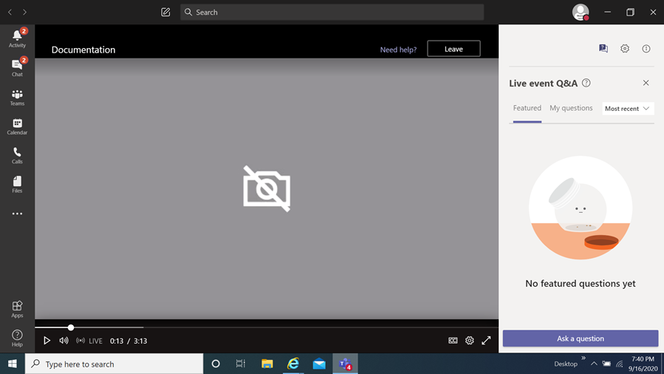
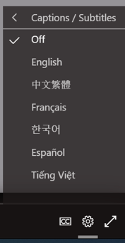
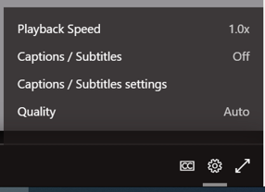
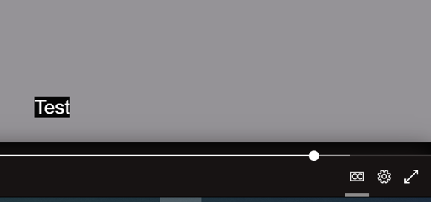
FY24 Healthy, Efficient, Electrified, Climate-Adapted Pilot (HEECAP) Homes Grants Program Information Session
How you can view the multi-lingual closed captions
Select this item
When you select it a menu appears,
choose captions / subtitles
It will then display the language chosen
You then select
the language of choice
Disclaimer
The translations provided in this application use what is referred to as mechanical translation technology. Although this method of translation is very effective and provides a high rate of accuracy it is NOT 100% word for word accurate. Things that may affect it are the quality of the microphone used and potentially a person speaking that may have an accent.

Slide 2
FY24 Healthy, Efficient, Electrified, Climate-Adapted Pilot (HEECAP) Homes Grants Program
Information Session
March 4, 2024
Prepared by Montgomery County Office of Grants Management

Slide 3
Welcome!
This meeting will be recorded and posted for future viewing on the Office of Grants Management online application portal
The slide deck will also be posted in the same location for your reference
Online Application Platform Home Page: https://mcmdgrants.smapply.org
Program Page:
https://mcmdgrants.smapply.org/prog/HEECAP
Outgoing Grants

Slide 4
Information Session Agenda
Provide an overview of the program
Walk through the application platform
Open up for participant questions (put your questions in the Q&A box)
Any questions we cannot answer during the Information Session will be addressed and posted on the platform
Outgoing Grants

Slide 5
FY24 HEECAP Homes
Overview
Program Goal: retrofit income-eligible houses for energy efficiency, a healthy indoor environment, climate resilience and all-electric appliances
Application Due Date: Monday, April 8, 2024 at 11:59 PM
Outgoing Grants

Slide 6
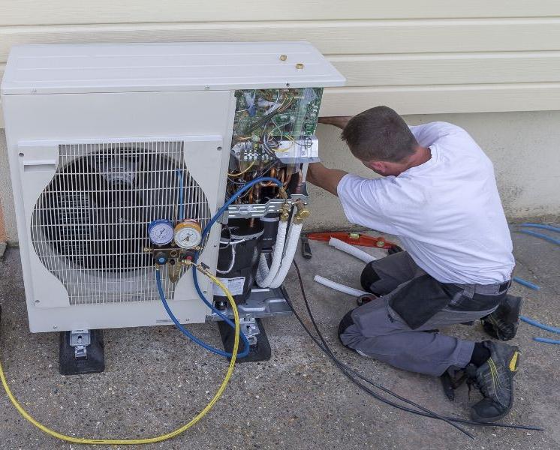
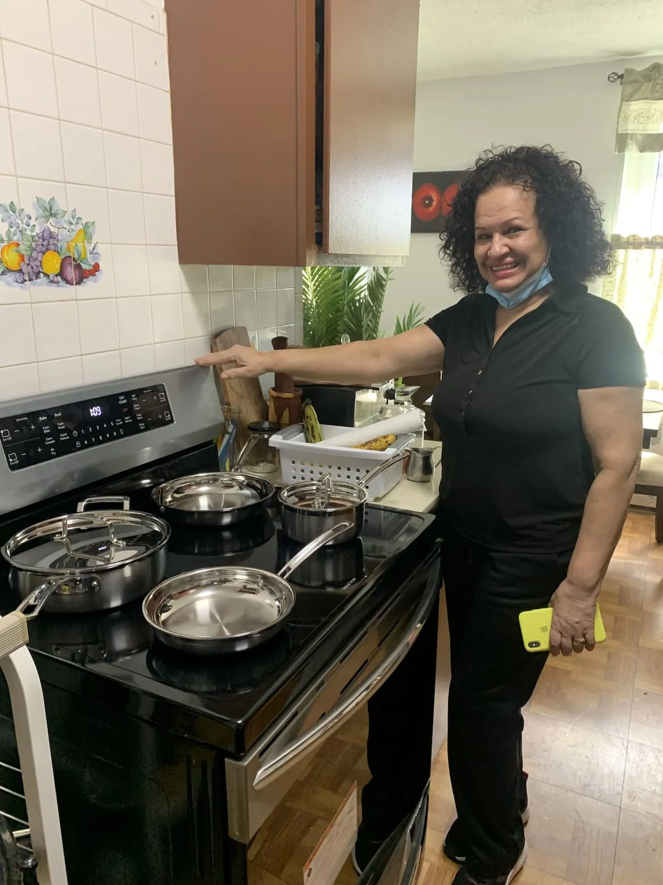
FY24 HEECAP Homes
Background/Target Population
Companion program to Electrify MC
Aligns with the
Montgomery County Climate Action Plan
Pilot new ideas to help the
target population of Low-to-Moderate
Income (LMI) residents (i.e., households
that have an income at or below 85% of the
Area Median Income for Montgomery County).
Outgoing Grants

Slide 7
FY24 HEECAP Homes
Background con’t
There are an interrelated set of challenges for LMI households in the County that the HEECAP Pilot Grant is poised to assist with:
High energy bills due to lack of weatherization and inefficient HVAC systems.
Costly home repairs that are out of reach to income-strapped households, including roof leaks, persistent flooding issues, and others that can cause significant building damage.
Disqualification from State-based weatherization programs due to health and safety problems that exceed limited repair budgets (e.g., $1500 for MEA).
Health hazards stemming from a poor indoor environment: mold, asbestos, unmitigated radon, pollution from outdoors or unconditioned spaces.
Climate change hazards that exacerbate the problems above.
Outgoing Grants

Slide 8
FY24 HEECAP Homes
Funding Priorities
Fill gaps not covered by existing federal, state and County programs
Pilot approaches that may be scaled up into more established, large-scale County programs in the future, with the goals of maximizing emission reduction and adapting to climate change
Nonprofits that are already working with LMI residents to improve household energy efficiency are best positioned to be awarded funding under this program
Montgomery County seeks proposals that apply a racial equity lens, demonstrate cultural proficiency, and inclusivity of the LGBTQIA+ community members
Outgoing Grants

Slide 9
FY24 HEECAP Homes
Illustrative Activities
Retrofit projects that remove fossil-fuel systems from homes and replace them with efficient electric systems, add batteries to onsite renewable energy systems, or perform other climate-resiliency measures not already funded through existing programs.
Home improvement projects that are not currently funded by existing income-eligible weatherization and/or energy efficiency programs that improve the safety and health of residents.
Leveraging County grant funding from this program to fix home problems that prevent LMI residents’ increased participation in existing weatherization and/or energy efficiency programs.
Outgoing Grants

Slide 10
Illustrative Activities – Training/Capacity Building
Description | Cost per Participant* | Number of Participants
Electrification/HVAC
Use of Manual J software approved by the Air Conditioning Contractors of America to develop HVAC load calculations | Up to $500 | 3 employees/subcontractors
Electrification-specific energy auditor training using the Building Performance Institute curriculum | Up to $750 | 3 employees/subcontractors
Remediation
IICRC Mold Remediation Specialist certification for mold remediation and restoration services | Up to $450 | 3 employees/subcontractors
Outgoing Grants

Slide 11
Illustrative Activities – Procurement and Installation
Type | Description and Requirements
Electrification of heating/cooling systems and domestic water heating | Replacement of fossil fuel heating system(s) with heat pump(s) that carry the entire heating/cooling load of the dwelling. See further specifications in the NOFO.
Asbestos testing and removal* | Testing and removal of Suspected Asbestos Containing Materials (SACM) if testing confirms that it contains asbestos. See further specification in the NOFO. Removal of flooring that contains asbestos will require County approval.
Window repair, replacement or installation* | This includes any required lead testing. County approval will be required for window replacements funded by this grant.
Roof repair/replacement | When there is documented need.
Electrical panel upgrades | Electrical panel “heavy up” to enable electrification of space heating, water heating, cooking, EV charging, installation of solar panels, and battery storage.
Electrical modernization | Replacement of knob and tube electrical wiring or branch circuit aluminum wiring to enable weatherization and electrification.
Outgoing Grants

Slide 12
Illustrative Activities – Procurement and Installation
Type | Description and Requirements
Solar battery storage systems | For resilience/standby power, complementing existing on-site PV solar
Chimney repair/removal | As needed for health and safety.
Interior repairs | Interior finish repair or replacement (walls, ceilings, floor coverings) up to 50% of total wall area to remediate water or mold damage. See further specification in the NOFO
Dehumidifiers | Room or permanently installed units, plus related controls to maintain the relative humidity below 60% in basements, crawl spaces and other areas that cannot be adequately dehumidified by the central HVAC system(s).
Radon mitigation systems | If measured radon levels are at or above the EPA's 4.0 pico-Curies per liter (pCi/L) action level measured with a short- or long-term test.
Flood insurance | Procurement of multi-year flood insurance coverage on residents’ behalf that aligns with the grant period of performance
Outgoing Grants

Slide 13
FY24 HEECAP Homes
Additional Considerations
Both single-family and multi-family properties are eligible
The grantee will be required to verify that any work undertaken and paid for through this program is not covered by homeowners’ or flood insurance.
The grantee will need to provide as part of their application a plan for how they will verify the eligibility of target populations
The grantee will be required to obtain all applicable permits from the relevant permitting authorities, such as the Montgomery County Department of Permitting Services, the Washington Suburban Sanitary Commission, or any other applicable permitting authority prior to commencing work.
Any rehabilitation or construction work will have to be preceded by site assessments that are adequately documented by narrative and photos to justify the work plan.
Outgoing Grants

Slide 14
FY24 HEECAP Homes
Eligible Expenses
Both capital and operating expenses are eligible expenses
Capital: one-time costs $5,000 or more in value that cover the purchase or significant improvement of a fixed asset
Operating: costs that support ongoing expenditures associated with projects
Preference for award will be given to proposals that maximize upgrades and capital improvements that align with program goals.
Outgoing Grants

Slide 15
FY24 HEECAP Homes
Ineligible Expenses
Any purchase or activity which has already been made outside the grant award period of performance
Purchases or activities unnecessary to accomplish grant purposes
Prior obligations of and/or, debts, fines, and penalties imposed on the Grantee
Lobbying
To supplant (replace) funds from other grant sources
To fund activities/home upgrades outside of Montgomery County, MD
These grants are generally not intended to fund consumable items. Care should be taken to install efficient items that do not create onerous ongoing expenses for residents (e.g., expensive ongoing maintenance; increased utility bills).
Installation of, or integration with, fossil-fuel appliances. The intent of this grants program is to entirely replace fossil-fuel appliances with efficient electric counterparts. For example, dual-fuel heat pumps with fossil-fuel backups are not eligible.
Outgoing Grants

Slide 16
FY24 HEECAP Homes
Ineligible Expenses
Gut rehabilitation or major structural repairs (e.g., unsafe foundation, collapsed floor/roof).
Replacement of entire plumbing, electrical, or HVAC systems (including ducts).
Replacement of windows or doors where existing units are not broken, missing, damaged beyond repair, or leaking and causing structural damage.
Repairs covered by homeowner’s or flood insurance.
Repairs needed due to willful damage or negligence on the part of the owner/occupant.
Cosmetic improvements (e.g., interior or exterior painting).
Repairs to detached garages, barns, sheds, or storage buildings.
Outgoing Grants

Slide 17
FY24 HEECAP Homes
Eligibility
The organization must have a federal 501(c)(3) or 501(c)(4) tax-exempt status or be a collaboration between two or more entities with at least one having this status.
The organization must be registered to perform home upgrade work in the state of Maryland (i.e., MHIC licensed contractors) AND/OR have the capacity to procure MHIC licensed subcontractors prior to performing upgrade work.
The organization must be currently registered and in Good Standing with the Maryland State Department of Assessments and Taxation (SDAT);
Recipients of home upgrades funded by this grant program must be located in Montgomery County, MD
Current Montgomery County contract or grant award winners must be current on all reporting obligations for other awards and those reports must reflect substantial progress towards the goals of their awards;
Proposed expenses must be for a new activity, expansion of existing activities, or a combination of both. County funding cannot be used to supplant other funding for already planned activities;
Applicants may only submit one application per organization under this NOFO.
Outgoing Grants

Slide 18
FY24 HEECAP Homes
Award Information
Total Funds​ | $1,500,000​
Anticipated number of awards​ | 1-5
Award Size​ | $300,000 - $1,500,000
Period of Performance​ | 12, 18 or 24 months​
Anticipated Types of Awards​ | Tranche-funded: kick-off meeting followed by quarterly reporting.
Outgoing Grants

Slide 19
Submission Guidelines
Submissions must come through the County’s SM Apply online application portal at https://mcmdgrants.smapply.org
All applications must be fully submitted online by Monday, April 8, 2024 at 11:59 PM
Applicants requesting an Americans with Disabilities Act (ADA) accommodation should contact the Office of Grants Management to discuss alternative submission options.
Outgoing Grants
Notes:
Switch to Rafael on this slide

Slide 20
Application Tasks
Applicant Information (Reusable) Task: Organization contact info and supporting documents (data fields and uploads)
Applicant Background (Reusable) Task: Organization size and leadership demographics (data collected will never be seen by Review Committees or used for awarding)
Licenses, Policies, and Procedures: MHIC license; procurement and subcontracting policies (data fields and uploads)
Project Strategy Task: Project data & narrative (5 page limit, data fields and uploads)
Project Budget and Budget Narrative Task: Project cost details (data fields, MS Excel upload); Budget Narrative/Justification Task: Brief explanation of the Project Budget (2 page limit, PDF upload) Optional Budget Template
Project Staffing Plan Task: key positions and SOW (2 page limit, PDF upload)
Project Work Plan/Timeline Task: Implementation schedule (1 page limit per year, PDF upload)
Performance Plan and History: Outline of metrics and outcomes to be achieved; evidence of capacity to successfully implement the project (2 page limit, PDF upload)
Optional Supporting Documents: (10 page limit per document, PDF upload
Outgoing Grants

Slide 21
Other Preparations
Register and create a profile on the online application platform for each team member who will be working on your application.
Verify that your organization is registered with the Maryland State Department of Assessment and Taxation (SDAT). Click here to go to the SDAT Business Express site to confirm. Even if your organization is registered in another jurisdiction, you must be registered with SDAT for Montgomery County to finalize an award with your organization.
If your organization is not in Good Standing with SDAT, take the necessary steps to get back into Good Standing. SDAT will advise what steps are required. Montgomery County cannot finalize an award with you or organization if you are not in Good Standing. Your application for a grant could be disqualified if you are not in Good Standing.
Register with the Montgomery County Central Vendor Registration System (CVRS) by clicking here. If you or your organization receives an award from the County then you will need to be registered with CVRS to receive payments.
Outgoing Grants

Slide 22
Review Process
Montgomery County Government will convene a review panel made up of qualified employees, and possibly the broader community, selected for their experiences in the grant program’s subject area, grants administration, and/or project management.
The panel members will review and score applicant proposals based on the criteria and priorities established in the NOFO.
Final decisions will be made based on the scores, reconciliation of funding across categories, and other factors such as applicants past performance on previous County awards.
Outgoing Grants

Slide 23
FY24 HEECAP Homes
Scoring
Project Goals and Grant Program Priorities (1-3 Rating; weighted at 20/100 points) – The proposal aligns with the funding priorities of the program.
Sound Fiscal Management and Budget (1-3 Rating; weighted at 20/100 points) – Applicant has robust grant and financial management systems
Organizational Capability (1-3 Rating; weighted at 30/100 points) – Applicant provides evidence of capability to undertake the proposed project and manage subcontractors (as applicable); Applicant demonstrates effectiveness in terms of internal structure, technical capacity, personnel, procurement, and subcontractor management (as applicable) systems in meeting the outcomes of the project; Applicant demonstrates the cultural, linguistic, and/or technical proficiency to work with their target population/community in the context of the proposed project; Applicant demonstrates capacity to reach and verify the eligibility of LMI residents.
Outgoing Grants

Slide 24
FY24 HEECAP Homes
Scoring con’t
D. Performance Plan and Performance History (1-3 Rating; weighted at 15/100 points) – The Performance Plan is aligned with the Project Strategy Narrative, Budget, and Work Plan.
E. Soundness of the Overall Proposal (1-3 Rating; weighted at 15/100 points) – Proposal clearly demonstrates the effectiveness of proposed activities and, if funded, will result in the accomplishment of their stated outcomes.
Outgoing Grants

Slide 25
Award Notification
Award notification letters are expected to be released roughly 4-6 weeks after the application deadline via email.
For successful applicants, the award agreement will contain funding restrictions; programmatic, administrative, and policy requirements; reporting documents including total budget along with the amount of grant funding for the program; and payment terms.
Outgoing Grants

Slide 26
Review Committee
Feedback: the Six Cs
Concise - Be concise, when possible. Review Committee Members (RCM) have difficulty absorbing information from long narratives.
Concrete – Be specific and direct in how your proposed project will achieve its stated goals. RCMs often see gaps in how a project will work.
Clarity – RCMs prefer that you include the question you are answering or add sub-headings for clarity. Application task uploads should also include the title of the application task, organization name and project title as headers.
Connection - All elements of your application should show a clear connection with the grant priorities and scoring criteria, as outlined in the NOFO.
Consistent - All elements of your application should be consistent with each other. RCMs often note a lack of consistency between budget and narratives.
Cite - Feel free to reference other application sections/Tasks (i.e. budget or staff plan) in your narratives. Specifically cite the application Task name so the RCM can go directly there. Hyperlinks to external sources (i.e. news article, research paper, your website, etc…) can be helpful too. Overall, no need to repeat information that is in other places in your application or external source.
Outgoing Grants

Slide 27
General Recommendations
Read and Follow Instructions in the NOFO!
Feel free to use graphics, charts, tables, maps, project workflows, and other non-narrative tools to clarify or enhance your proposal.
Develop, coordinate, and finalize your application offline and then upload all materials into the application.
Uploads in pdf format are preferred (except the Program Budget, MS Excel please) but other formats are also welcome. The application platform has difficulty reading Mac formatted documents (i.e. Pages, Numbers, and Key Note) so these should be submitted as PDFs or converted to MS Office formats.
Outgoing Grants

Slide 28
Resources
The following resources are/will be posted on the application page:
Notice of Funding Opportunity (NOFO)
Link to a recording of the Information Session
Information Session slide deck
FY24 HEECAP Optional Budget Template
OGM Answers to Information Session and Frequently Asked Questions
Outgoing Grants

Slide 29
Further Questions?
Olga Kravets
Outgoing Grants Program Manager
Office of Grants Management
240-773-3344
grants@montgomerycountymd.gov
OGM online grants application platform for information, updates,
and to apply for County Grants (OGM website coming soon)
https://mcmdgrants.smapply.org

