Slide 1
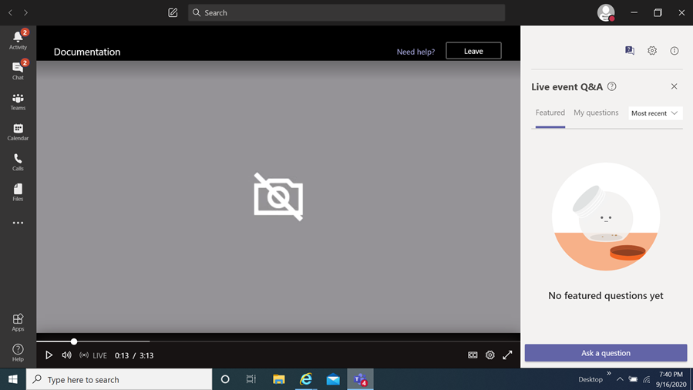
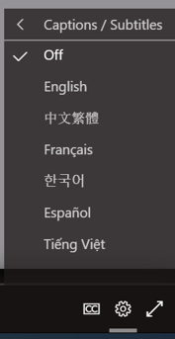
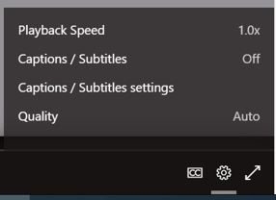
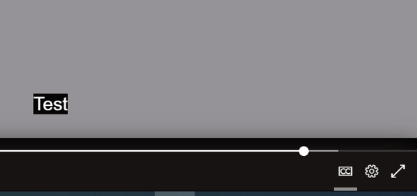
FY24 Enhanced Mobility
Grants Program Information Session
How you can view the multi-lingual closed captions
Select this item
When you select it a menu appears,
choose captions / subtitles
It will then display the language chosen
You then select
the language of choice
Disclaimer
The translations provided in this application use what is referred to as mechanical translation technology. Although this method of translation is very effective and provides a high rate of accuracy it is NOT 100% word for word accurate. Things that may affect it are the quality of the microphone used and potentially a person speaking that may have an accent.

Slide 2
FY24 Enhanced Mobility
Grant Program Information Session
November 20, 2023
Prepared by Montgomery County Office of Grants Management

Slide 3
Welcome!
This meeting will be recorded and posted for future viewing on the Office of Grants Management online application portal
The slide deck will also be posted in the same location for your reference
Online Application Platform Home Page: https://mcmdgrants.smapply.org
Program Page:
https://mcmdgrants.smapply.org/prog/fy24_enhanced_mobility/

Slide 4
Information Session Agenda
Provide an overview of the program
Walk through the application platform
Open up for participant questions (put your questions in the Q&A box)
Any questions we cannot answer during the Information Session will be addressed and posted on the platform
Notes:
Switch to DHHS after this slide

Slide 5
FY24 Enhanced Mobility
Grants Program
Program Goal: increase access to transportation services for Montgomery County residents who are disabled as well as seniors, individuals with limited incomes, and other vulnerable populations, specifically in Underserved Communities.
Application Due Date: Monday, January 8, 2024 at 11:59 PM
Notes:
Switch to DHHS on this slide

Slide 6
FY24 Enhanced Mobility
Grants Program
Target Populations:
Individuals with physical, emotional, and/or intellectual disabilities
Seniors 63 years old and older (same eligibility for MCDOT’s Call-n-Ride Program)
Individuals with limited incomes aged 18-62
Other vulnerable populations residing in Montgomery County, specifically in Underserved Communities
Notes:
Switch to DHHS on this slide

Slide 7
FY24 Enhanced Mobility
Grants Program
Funding Priorities:
Demonstrate a commitment to, and experience with, increasing access to transportation for at least one of the target populations (see previous slide)
Exhibit cultural proficiency and use a racial equity lens in providing services;
Transport individuals who are disabled, especially those who live in traditionally underserved areas of Montgomery County;
Work with ethnically diverse communities where English is not the first language;
Work to keep seniors engaged and in touch with much needed safety net services;
Work with youth in high FARMS (Free and Reduced Meals Program) areas

Slide 8
FY24 Enhanced Mobility
Grants Program
Eligibility:
501(c)3 tax-exempt status (or a collaboration with another organization that has this status)
In Good Standing with SDAT
Proposed activity must be in MoCo or be exclusively for MoCo residents
If current awardee or contract holder, be up-to-date on all reporting and show progress towards achieving goals
1 application per applicant
Notes:
Switch to DHHS on this slide

Slide 9
FY24 Enhanced Mobility
Grants Program
Eligibility con’t:
The organization must provide transportation, public health, and/or community benefit services that address the needs of at least one group of individuals identified in the Funding Priorities
Proposed expenses must be for a new activity, expansion of existing activities, or a combination of both. County funding cannot be used to supplant other funding for already planned activities
Have sound financial, administrative, and technical policies and procedures
Notes:
Switch to DHHS on this slide

Slide 10
FY24 Enhanced Mobility
Grants Program
Eligible Expenses:
Capital - Expenses that are $5,000 or more one-time costs for the purchase of a fixed asset. For example, procurement of a car, property, remodeling a property, building an addition to a community center etc. Illustrative examples:
• Purchase, or retrofit, of a vehicle to a wheelchair accessible vehicle
• Purchase of a multi-passenger van
• Purchase of or retrofit to an adaptable vehicle for shared use, or as a training vehicle to build confidence among program participants to operate a vehicle on their own
Notes:
Switch to DHHS on this slide

Slide 11
FY24 Enhanced Mobility
Grants Program
Eligible Expenses:
Operating - Support ongoing costs associated with projects. For example, salaries, benefits, supplies, rent, contractor trainers and other expenses over the life of a project. Illustrative examples:
• Offsetting the cost of maintenance, fuel, insurance, and other fees necessary to keep a vehicle road ready
• Provision of salary or stipend to individuals who provide transportation services to the target population groups
• Purchase of transportation related gift cards for ride hailing services such as Uber and Lyft
Notes:
Switch to DHHS on this slide

Slide 12
FY24 Enhanced Mobility
Grants Program
Ineligible Expenses:
• Reimbursement for the purchase of a hybrid or alternative fuel vehicle through this program unless the vehicle is a wheelchair accessible vehicle or multipassenger van
• Purchase of Personally Owned Vehicles. All vehicles purchased under this program should be for organizations, not individuals, providing services
• Installation of equipment relevant to the operation of a vehicle (e.g. electric charging station) cannot be at a local residence
• To purchase safety net materials, such as food, medical supplies, clothing, etc.
• Any purchase or activity which has already been made

Slide 13
FY24 Enhanced Mobility
Grants Program
Ineligible Expenses con’t:
• Purchases or activities unnecessary to accomplish grant purposes
• Prior obligations of and/or, debts, fines, and penalties imposed on the Grantee
• Lobbying
• To supplant (replace) funds from other grant sources
• To provide services that wholly occur outside of Montgomery County. For example, taking a senior living in Silver Spring to a medical appointment in Baltimore and returning them home would be allowed. Transportation services within Baltimore alone are not eligible expenses

Slide 14
FY24 Enhanced Mobility
Grants Program
Award Information
Total Funds | $800,000 ($640,000 for capital and $160,000 for operating expenses)
Anticipated number of awards | 8-10
Award Size | $20,000 - $105,000
Ceiling for capital expenses | $65,000
Ceiling for operating expenses | $40,000
Period of Performance | no more than 12 months
Anticipated Grant Agreement Start Date | March 1, 2024
Anticipated Types of Awards | Cost reimbursable smaller awards for operating expenses only negotiable

Slide 15
Submission Guidelines
Submissions must come through the County’s SM Apply online application portal at https://mcmdgrants.smapply.org
All applications must be fully submitted online by Monday, January 8, 2024 at 11:59 PM
Applicants requesting an Americans with Disabilities Act (ADA) accommodation should contact the Office of Grants Management to discuss alternative submission options.
Notes:
Switch to Rafael on this slide

Slide 16
Application Tasks
Applicant Information (Reusable) Task: Organization contact info and supporting documents (data fields and uploads)
Applicant Background (Reusable) Task: Organization size and leadership demographics (data collected will never be seen by Review Committees or used for awarding)
Project Narrative Task: Project data & narrative (2 page limit, PDF upload)
Project Outreach Plan: articulates how target audience will be reached (1 page limit, PDF)
Project Budget Task: Project cost details (No page limit, MS Excel upload); Budget Narrative/Justification Task: Brief explanation of the Project Budget (1 page limit, PDF upload)
Project Work Plan/Timeline: Implementation schedule (1 page limit per year, PDF upload)
Performance Plan: Outline of metrics and outcomes to be achieved (1 page limit each, PDF upload)
Optional Supporting Documents to be Uploaded Task: Optional additional uploads (no limit, PDF uploads)
Full Task requirements and guidance on the FY24 Enhanced Mobility Grants Program Page

Slide 17
Recorded Task Trainings
OGM has provided additional trainings specific to each Task focused on more detailed explanations of the Task, optional templates, and past Review Committee feedback on what they felt was useful. The PowerPoint slides from these trainings are available on the MCG Grants Portal home page.
Training Topic | Link to Recording/ PowerPoint slides
Applicant Information and Applicant Background Reusable Tasks | View Session 1 Recording View Session 1 Slides
Project Strategy and Project Work Plan/Timeline Tasks | View Session 2 Recording View Session 2 Slides
Project Budget, Project Budget Narrative/Justification, and Project Staffing Plan Tasks | View Session 3 Recording View Session 3 Slides
Performance Plan and Performance History Task | View Session 4 Recording View Session 4 Slides

Slide 18
Preparations
Register and create a profile on the online application platform for each team member who will be working on your application.
Verify that your organization is registered with the Maryland State Department of Assessment and Taxation (SDAT). Click here to go to the SDAT Business Express site to confirm. Even if your organization is registered in another jurisdiction, you must be registered with SDAT for Montgomery County to finalize an award with your organization.
If your organization is not in Good Standing with SDAT, take the necessary steps to get back into Good Standing. SDAT will advise what steps are required. Montgomery County cannot finalize an award with you or organization if you are not in Good Standing. Your application for a grant could be disqualified if you are not in Good Standing.
Register with the Montgomery County Central Vendor Registration System (CVRS) by clicking here. If you or your organization receives an award from the County then you will need to be registered with CVRS to receive payments.

Slide 19
Review Process
MCDOT will convene a review panel made up of qualified individuals in Montgomery County Government, and possibly the broader community, selected for their experiences in the grant program’s subject area, grants administration, and/or project management.
The panel members will review and score applicant proposals based on the criteria and priorities established in the NOFO.
Final decisions will be made based on the scores, reconciliation of funding across categories, and other factors such as applicants past performance on previous County awards.

Slide 20
Scoring – Confidence Rating
Soundness of the Proposed Project (1-3 Rating; weighted at 25/100 points) – The proposed project results are consistent with the FY24 Enhanced Mobility Grants Program goal and Funding Priorities
Relevance of Program Goals, Objectives and Services (1-3 Rating; weighted at 20/100 points) – Project goals and supporting objectives and activities are relevant, clearly defined, measurable, and time specific
Organizational and Relevant Experience (1-3 Rating; weighted at 20/100 points) – Applicant demonstrates the cultural proficiency to work with their target communities/beneficiaries and, if applicable, language minority populations

Slide 21
Scoring – Confidence Rating
D. Sound Fiscal Management Capacity and Budget (1-3 Rating; weighted at 15/100 points) – Applicant demonstrates sound fiscal management
E. Community Outreach (1-3 Rating; weighted at 20/100 points) – Applicant proposes an effective community outreach plan to connect with the target populations to promote programs and/or services to existing and new potential clients;

Slide 22
Award Notification
Award notification letters are expected to be released roughly 4-6 weeks after the application deadline via email.
For successful applicants, the award agreement will contain funding restrictions; programmatic, administrative, and policy requirements; reporting documents including total budget along with the amount of grant funding for the program; and payment terms.

Slide 23
Review Committee
Feedback: the Six Cs
Concise - Be concise, when possible. Review Committee Members (RCM) have difficulty absorbing information from long narratives.
Concrete – Be specific and direct in how your proposed project will achieve its stated goals. RCMs often see gaps in how a project will work.
Clarity – RCMs prefer that you include the question you are answering or add sub-headings for clarity. Application task uploads should also include the title of the application task, organization name and project title as headers.
Connection - All elements of your application should show a clear connection with the grant priorities and scoring criteria, as outlined in the NOFO.
Consistent - All elements of your application should be consistent with each other. RCMs often note a lack of consistency between budget and narratives.
Cite - Feel free to refence other application sections/Tasks (i.e. budget or staff plan) in your narratives. Specifically cite the application Task name so the RCM can go directly there. Hyperlinks to external sources (i.e. news article, research paper, your website, etc…) can be helpful too. Overall, no need to repeat information that is in other places in your application or external source.

Slide 24
General Recommendations
Read and Follow Instructions!
Feel free to use graphics, charts, tables, maps, project workflows, and other non-narrative tools to clarify or enhance your proposal.
Develop, coordinate, and finalize your application offline and then upload all materials into the application.
Uploads in pdf format are preferred (except the Program Budget, MS Excel please) but other formats are also welcome. The application platform has difficulty reading Mac formatted documents (i.e. Pages, Numbers, and Key Note) so these should be submitted as PDFs or converted to MS Office formats.
Start now on getting your legal house in order, if needed.

Slide 25
Resources
The following resources will be posted on the application page:
Notice of Funding Opportunity (NOFO)
Link to a recording of the Information Session
Information Session slide deck
5 Steps to Preparing for Montgomery County Grants hand out
Eligibility Checklist
Application Checklist
Links to General Application Training Videos and Slide Decks
OGM Answers to Information Session and Frequently Asked Questions

Slide 26
Further Questions?
Olga Kravets
Outgoing Grants Program Manager
Office of Grants Management
240-773-3344
grants@montgomerycountymd.gov
OGM online grants application platform for information, updates,
and to apply for County Grants (OGM website coming soon)
https://mcmdgrants.smapply.org

