Slide 1
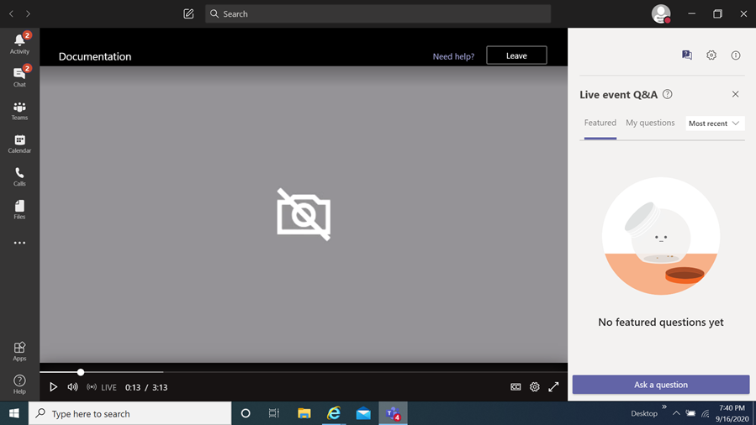
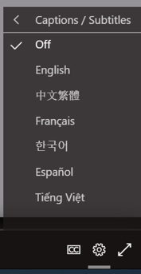
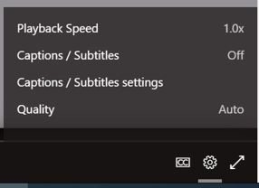
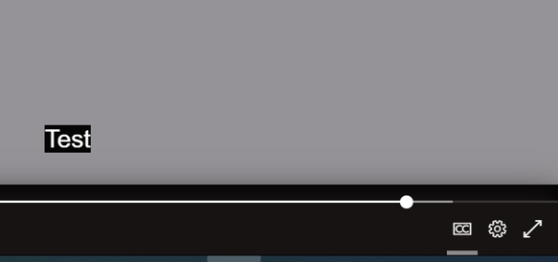
Second Quarter FY24 Community Projects Fund
Grant Program Information Session
How you can view the multi-lingual closed captions
Select this item
When you select it a menu appears,
choose captions / subtitles
It will then display the language chosen
You then select
the language of choice
Disclaimer
The translations provided in this application use what is referred to as mechanical translation technology. Although this method of translation is very effective and provides a high rate of accuracy it is NOT 100% word for word accurate. Things that may affect it are the quality of the microphone used and potentially a person speaking that may have an accent.

Slide 2
Second Quarter FY24 Community Projects Fund
& FY24 Fentanyl Use, Overdose, and Death Reduction Grant Programs Information Session
October 11, 2023
Prepared by Montgomery County Office of Grants Management

Slide 3
Welcome!
This meeting will be recorded and posted for future viewing on the Office of Grants Management online application portal
The slide deck will also be posted in the same location for your reference
Online Application Platform Home Page: https://mcmdgrants.smapply.org
Program Page:
https://mcmdgrants.smapply.org/prog/FY24CPFQ2/

Slide 4
Information Session Agenda
Provide an overview of the program
Walk through the application platform
Open up for participant questions (put your questions in the Q&A box)
Any questions we cannot answer during the Information Session will be addressed and posted on the platform
Notes:
Switch to DHHS after this slide

Slide 5
FY24 Community Projects
Fund Grant Program
Provides $1 million in one-time funding for small, emerging, and volunteer led nonprofit organizations to implement small, community focused projects, initiatives, and events.
A quarterly application with at least $250,000 available in each cycle. Additional funding may be added to this pool from other County sources and may have additional priorities, restrictions, and/or requirements.
The performance period will be six (6) months from the award date as the goal of this program is to support specific, short-term initiatives instead of ongoing, full, or multi-year programs.
Funding may be awarded to new initiatives OR to projects supported by Community Grants in previous fiscal years.
These grants cannot be used for the expansion of existing County funded programs; including FY24 Bridge Funding for the First Quarter.
Notes:
Switch to DHHS on this slide

Slide 6
FY24 Community Projects
Fund Grant Program
Second Quarter FY24 CPF is open for applications
Application Due Date: Tuesday October 31, 2023 at 11:59 PM
Applicants may request funding between $5,000 and $25,000
The remaining FY24 CPF quarterly cycles will launch on:
Third Quarter Applications Open: Monday January 1, 2024
Fourth Quarter Applications Open: Monday April 1, 2024
Notes:
Switch to DHHS on this slide

Slide 7
FY24 Fentanyl Use, Overdose, and
Death Reduction (FOUDR) Grant Program
Goal of reducing the number of persons using, overdosing and dying from the use of fentanyl in Montgomery County, MD.
Open to ANY nonprofit providing these services
Can be expansions of existing programs/activities
Four one-time awards are anticipated at $25,000 each.
Period of performance for up to a year.
Supporting new as well as existing programs.
Applications Due Tuesday October 31, 2023 at 11:59 PM
Unless differences are specifically stated, all information presented will apply to both programs.
Notes:
Switch to DHHS on this slide

Slide 8
Q2 FY24 Community Project Funds
 | FY24 Community Project Funds (CPF) | FY24 Fentanyl Use, Overdose, and Death Reduction Grant Program
Target Nonprofit: | Small, emerging, and volunteer led nonprofits | Any nonprofit who provides these services
Total Funding: | $1 million over four quarters with $250,000 for Q2 | $100,000
Award Range: | $5,000 to $25,000 | Four awards of $25,000
Performance Period: | Flexible range of up to 6 months | Flexible range of up to 12 months
Number of Applications: | One | Can submit multiple applications but only one award per organization
Application Opened: | Sunday October 1, 2023 | Sunday October 1, 2023
Application Deadline: | Tuesday October 31, 2023 at 11:59 PM | Tuesday October 31, 2023 at 11:59 PM
Where to apply: | https://mcmdgrants.smapply.org/prog/FY24CPFQ2/ | https://mcmdgrants.smapply.org/prog/FY24CPFQ2/
Notes:
??????????????????add this

Slide 9
Target Population
The target populations for this Grant Program are Montgomery County residents.
This Grant Program is intentionally very flexible and allows nonprofit partners to define their own specific target populations within Montgomery County.
Priority to awarding funding will be given to projects that target Underserved Communities within Montgomery County.
FY24 FOUDR - all those using or at risk for using fentanyl in Montgomery County, MD.
Notes:
Switch to DHHS on this slide

Slide 10
Target Nonprofits
Small - Nonprofits with an annual budget of less than $250,000 and with less than three full-time employees. These organizations do not have the intent to significantly expand and are focused on their existing range programs and communities served.
Emerging – Same general definition of a Small Nonprofit buy these organization have the intent to significantly expand their range of programs and communities served.
Volunteer Led –The organization may hire contractors for specific program (i.e. seminar trainer) or administrative services (i.e. accounting) or pay staff/volunteers small stipends but the organization has no full-time staff.
FY24 FOUDR – Any nonprofit that provides the target services.
Notes:
Switch to DHHS on this slide

Slide 11
CPF Award Priorities
Priority in awarding funding will be given to proposals that:
Are from small, emerging, or volunteer led nonprofit organizations;
Are from organizations based in or serving an Underserved Community;
Demonstrate a strong understanding of their target population’s/community’s needs and an effective project strategy to effectively meets these needs;
Provide services, advocacy, or other support to the target population/community that is not already funded by other County resources;
Provide technically, culturally, and/or linguistically proficient services to the target population/community;
Demonstrate a broad base of impact through their proposal to their target population/community; and
Will be fully implemented within six (6) months of the award date.

Slide 12
CPF Priority Examples
Previously funded Community Grants include, but are not limited to:
Development costs for a guidebook, curricula, or other resource to be used by the target community;
Translation costs for a similar set of community resources;
One-time activities such as a cultural festival, youth camp during a school break, senior job fair, or other community event;
Short-term activities such after-school academic tutoring, youth development and mentorship sessions, accessibility focused projects, and courses; or
Operating support for basic needs service providers targeting unique Underserved Communities;
Both new and historical Community Grants nonprofit partners are not limited by the list above.

Slide 13
FY24 FOUDR Priorities
Programming occurring in the following zip codes: 20910, 20860, 20912, 20877, and 20842
MCG will prioritize the following kinds of proposed activities:
Single events or ongoing programs.
Prevention education activities held in person or via virtual platforms (e.g., Zoom, Microsoft Teams, etc.).
Those that include stipends for peer support.
Notes:
Switch to DHHS on this slide

Slide 14
FOUDR Priority Examples
Tuition support to attend an after-school programs
Youth outreach programs (funding to attend youth-oriented events such as sports, art workshops, music festivals, etc. That focus on alternatives to drug use and keep kids engaged in positive activities)
Winter/summer camp tuition assistance
Educational workshops & presentations
Public awareness campaigns
Parent & caregiver workshops
Community events
Small incentives to participate in drug-free programs or attending educational events (gift cards, rewards, certificates, etc. Giving money directly to participants will not be approved).
Stipends for peer support, community service workers to support events
Online outreach- create social media profiles dedicated to providing information about the dangers of fentanyl. Share informative articles, videos, and success stories of individuals who have overcome substance abuse.
MCG will not fund activities that give money directly to participants.
Notes:
Switch to DHHS on this slide

Slide 15
Shared Award Priorities
OGM seeks proposals from organizations that:
Exhibit cultural proficiency;
Are inclusive of the LGBTQIA+ community members;
Use a racial equity lens in providing services.
Other Notes on Priorities:
The range of programming allowed is intentionally very flexible.
Applicants are encouraged to identify new needs and other innovative projects for their target populations/communities.
Organizations with other County funded projects may still apply for separate projects under both Grant Programs.

Slide 16
Eligibility (1 of 2)
The organization must have a Federal 501(c)(3) tax-exempt status or be a collaboration between two or more entities with at least one having this status
FOUDR also allows 501(c)(6)s commercial nonprofits to apply
The organization must be currently registered and in good standing with the Maryland State Department of Assessments and Taxation (SDAT);

Slide 17
Eligibility (2 of 2)
All activities and expenditures under this grant program must be provided in Montgomery County OR be exclusively for Montgomery County residents if activities and expenditures occur outside of the County;
Current Montgomery County contract or grant award winners must be current on all reporting obligations for other awards and those reports must reflect substantial progress towards the goals of their awards; and
Proposed expenses must be for a new activity, expansion of existing activities, or a combination of both. County funding cannot be used to supplant other funding for already planned activities.

Slide 18
Submission Guidelines
Submissions must come through the County’s SM Apply online application portal at
https://mcmdgrants.smapply.org
All applications must be fully submitted online by Tuesday October 31, 2023 at 11:59 PM
Applicants requesting an Americans with Disabilities Act (ADA) accommodation should contact the Office of Grants Management to discuss alternative submission options.

Slide 19
Application Tasks
Applicant Information (Reusable) Task: Organization contact info and supporting documents (data fields and uploads)
Applicant Background (Reusable) Task: Organization size and leadership demographics (data collected will never be seen by Review Committees or used for awarding)
Project Strategy Task: Project data & narrative (data fields & 1 page PDF upload) Note: FY24 CPF and FOUDR Grant Programs have slightly different narrative questions.
Project Budget Task: Project cost details (data fields, MS Excel upload, & 1 page PDF upload)
Project Work Plan/Timeline: Implementation schedule (1 page PDF upload)
Performance Plan: Outline of metrics and outcomes to be achieved (1 page PDF upload)
Optional Supporting Documents to be Uploaded Task: Optional additional PDF uploads
Full Task requirements and guidance on the FY24 Q2 Community Projects Fund Page

Slide 20
Recorded Task Trainings
OGM has provided additional trainings specific to each Task focused on more detailed explanations of the Task and past Review Committee feedback on what they felt was useful. The PowerPoint slides from these trainings are available on the MCG Grants Portal home page.
Training Topic | Link to Recording/ PowerPoint slides
Applicant Information and Applicant Background Reusable Tasks | View Session 1 Recording View Session 1 Slides
Project Strategy and Project Work Plan/Timeline Tasks | View Session 2 Recording View Session 2 Slides
Project Budget, Project Budget Narrative/Justification, and Project Staffing Plan Tasks | View Session 3 Recording View Session 3 Slides
Performance Plan and Performance History Task | View Session 4 Recording View Session 4 Slides

Slide 21
Ethics Questions
Does your organization employ current employees or contractors of the Montgomery County Government? This applies for employees that are paid by your organization but are also paid by Montgomery County Government.
Does your organization's Board of Directors include current employees or contractors of the Montgomery County Government? This applies to volunteer board of director positions.
If you answered yes to either question, please describe the employee(s) role and function as it applies to your organization. Answering “yes” to either question does not exclude your organization from being eligible to apply.
Montgomery College, Montgomery County Public Schools, and WorkSource Montgomery do not count as Montgomery County Government employees for the purpose of this Grant Program.
If you are unsure if a position applies please contact the Office of Grants Management.

Slide 22
Other Preparations
Register and create a profile on the online application platform for each team member who will be working on your application.
Verify that your organization is registered with the Maryland State Department of Assessment and Taxation (SDAT). Click here to go to the SDAT Business Express site to confirm. Even if your organization is registered in another jurisdiction, you must be registered with SDAT for Montgomery County to finalize an award with your organization.
If your organization is not in Good Standing with SDAT, take the necessary steps to get back into Good Standing. SDAT will advise what steps are required. Montgomery County cannot finalize an award with you or organization if you are not in Good Standing. Your application for a grant could be disqualified if you are not in Good Standing.
Register with the Montgomery County Central Vendor Registration System (CVRS) by clicking here. If you or your organization receives an award from the County then you will need to be registered with CVRS to receive payments.

Slide 23
Review Process
OGM will convene a review panel made up of qualified neutral, qualified individuals in Montgomery County Government, and possibly the broader community, selected for their experiences in the grant program’s subject area, grants administration, and/or project management.
The panel members will review and score applicant proposals based on the criteria and priorities established in the NOFO.
Final decisions will be made based on the scores, reconciliation of funding across categories, and other factors such as applicants past performance on previous County awards.

Slide 24
Scoring – 100 Possible Points
Project Goals and Grant Program Priorities (20 points) – How does the project’s goals match the priorities of the program?
Sound Fiscal Management and Budget (15 points) – Is the budget manageable, reasonable, and reflective of project?
Organizational Capability and Relevant Experience (35 points) – Does the org have the cultural competency, expertise, and community connection needed to implement project?
Performance Plan (10 points) – Does the organization demonstrate a strong plan to measure its success?
Soundness of the Overall Proposal (20 points) – Does the project demonstrate a strong overall strategy to achieving its target outcomes?

Slide 25
Award Notification
Award notification letters are expected to be released roughly 4-6 weeks after the application deadline via email.
For successful applicants, the award agreement will contain funding restrictions; programmatic, administrative, and policy requirements; reporting documents including total budget along with the amount of grant funding for the program; and payment terms.

Slide 26
Review Committee
Feedback: the Seven Cs
Concise - Be concise, when possible. Review Committee Members (RCM) have difficulty absorbing information from long narratives.
Concrete – Be specific and direct in how your proposed project will achieve its stated goals. RCMs often see gaps in how a project will work.
Clarity – RCMs prefer that you include the question you are answering or add sub-headings for clarity. Application task uploads should also include the title of the application task, organization name and project title as headers.
Connection - All elements of your application should show a clear connection with the grant priorities and scoring criteria, as outlined in the NOFO.
Consistent - All elements of your application should be consistent with each other. RCMs often note a lack of consistency between budget and narratives.
Cite - Feel free to refence other application sections/Tasks (i.e. budget) in your narratives. Specifically cite the application Task name so the RCM can go directly there. Hyperlinks to external sources (i.e. news article, research paper, your website, etc…) can be helpful too. Overall, no need to repeat information that is in other places in your application or external source.
Complete – Before clicking Submit, go back and make sure you finished all Tasks, filled out all fields, and uploaded the right attachment in the right place.

Slide 27
General Recommendations
Read the guidelines and instructions in the NOFO and follow them.
Feel free to use graphics, charts, tables, maps, project workflows, and other non-narrative tools to clarify or enhance your proposal.
Video or alternative media submissions are also an option.
Develop, coordinate, and finalize your application offline and then upload all materials into the application.
Uploads in pdf format are preferred (except the Program Budget, MS Excel please) but other formats are also welcome.
The application platform has difficulty reading Mac formatted documents (i.e. Pages, Numbers, and Key Note) so these should be submitted as PDFs or converted to MS Office formats.
Start now on getting your legal house in order, if needed.

Slide 28
Application Support Resources
The following resources will be posted on the application page:
Notice of Funding Opportunity (NOFO)
Link to a recording of the Information Session
Information Session slide deck
5 Steps to Preparing for Montgomery County Grants hand out
Eligibility Application Check List
Completeness Application Check List
Sample Application Package
Links to General Application Training Videos and Slide Decks
OGM Answers to Information Session and Frequently Asked Questions

Slide 29
Further Questions?
Olga Kravets
Outgoing Grants Program Manager
Office of Grants Management
240-773-3344
grants@montgomerycountymd.gov
OGM Website
https://montgomerycountymd.gov/ogm/
OGM online grants application platform https://mcmdgrants.smapply.org

