Slide 1
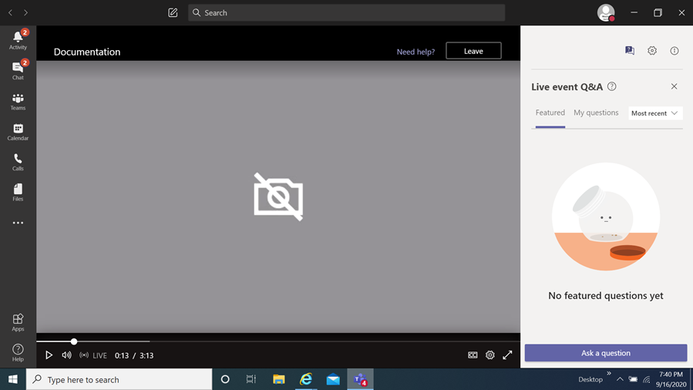
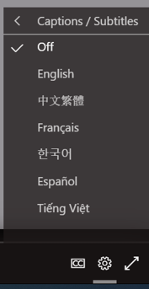
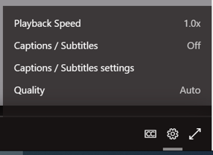
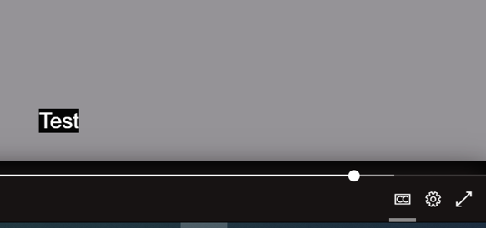
FY24 Cost Sharing Capital Grants
Information Session
How you can view the multi-lingual closed captions
Select this item
When you select it a menu appears,
choose captions / subtitles
It will then display the language chosen
You then select
the language of choice
Disclaimer
The translations provided in this application use what is referred to as mechanical translation technology. Although this method of translation is very effective and provides a high rate of accuracy it is NOT 100% word for word accurate. Things that may affect it are the quality of the microphone used and potentially a person speaking that may have an accent.

Slide 2
FY24 Cost Sharing Capital Grants
Information Session
February 26, 2024
Prepared by Montgomery County Office of Grants Management

Slide 3
Welcome!
This meeting will be recorded and posted for future viewing on the Office of Grants Management online application portal
The slide deck will also be posted in the same location for your reference
Online Application Platform Home Page: https://mcmdgrants.smapply.org
Program Page:
https://mcmdgrants.smapply.org/prog/FY24CSCG
Outgoing Grants

Slide 4
Information Session Agenda
Provide an overview of the program
Walk through the application platform
Open up for participant questions (put your questions in the Q&A box)
Any questions we cannot answer during the Information Session will be addressed and posted on the platform
Outgoing Grants

Slide 5
FY24 CSCG Notice of
Funding Opportunity (NOFO)
Download the UPDATED full FY24 Cost Sharing Capital Grants (CSCG) NOFO in PDF format.
Updates to NOFO from February 14, 2024:
Added definition of Arts Facility Capital Project on pages 3 and 9
Added word limits for questions to match application module Project Scope of Work (page 10) and Project Budget & Budget Narrative (page 11) Tasks
Added more details on the reviewing and scoring process (page 15)
Outgoing Grants

Slide 6
FY24 CSCG Overview
Program Goal: support capital projects led by 501(c)(3) nonprofit organizations that provide access to resources, direct services, historical preservation, cultural enrichment, and/or other benefits to Montgomery County residents.
Application Due Date: Tuesday, March 19, 2024 at 3:00 PM
Outgoing Grants

Slide 7
Funding Categories (1 of 2)
(1) Arts Facility Capital Grants - $1 million total available
Arts Facility Definition: Capital project has its primary mission or objective as the exhibition, presentation, production or performance of, and/or education in, an arts and/or humanities discipline, and/or provides support services to artists and/or scholars and/or arts and/or humanities organizations.
• $750,000 to match appropriated Maryland State Bond Bills (or other forms of Maryland State capital funding)
• $250,000 for other, small Arts Facility Capital Projects
(2) Non-Arts Capital Grants - $2 million total available
• $1.25 million to match appropriated Maryland State Bond Bills (or other forms of Maryland State capital funding)
• $750,000 for other, small Capital Projects
Outgoing Grants

Slide 8
Funding Categories (2 of 2)
Award Information | Arts Facility Capital Projects | Non-Arts Capital Projects
State Match | $750,000 available in FY24; $25,000 to $750,000 request range; and Awarded across up to three (3) fiscal years. | $1,250,000 available in FY24; $25,000 to $1 million maximum request range; Awarded across up to three (3) fiscal years.
Small Projects | $250,000 available in FY24; $25,000 to $100,000 request range; and Awarded in a single fiscal year. | $750,000 available in FY24; $25,000 to $100,000 request range; and Awarded in a single fiscal year.
Award Type | Cost reimbursable
Deadline | Tuesday, March 19, 2024 at 3:00 PM
Application Site | https://mcmdgrants.smapply.org/prog/FY24CSCG
Outgoing Grants

Slide 9
FY24 CSCG Target Populations
Target Population: Montgomery County residents. Priority in awarding funding will be given to projects that demonstrate a commitment to and impact on Underserved populations in Montgomery County.
“Populations sharing a particular characteristic, as well as geographic communities, that have been systematically denied a full opportunity to participate in aspects of economic, social, and civic life such as Black, Latino, and Indigenous and Native American persons, Asian Americans and Pacific Islanders and other persons of color; members of religious minorities; lesbian, gay, bisexual, transgender, and queer (LGBTQIA+) persons; persons with disabilities; persons who live in rural areas; and persons otherwise adversely affected by persistent poverty or inequality.”
January 20, 2021 Executive Order on Advancing Racial Equity and Support for Underserved Communities Through the Federal Government.
Outgoing Grants

Slide 10
FY24 CSCG Priorities (1 of 2)
Funding Priorities: priority in awarding funding will be given to projects that demonstrate:
Funding Priority #1: A commitment to and impact on Underserved populations in Montgomery County. If targeting an Underserved population or community, applicants should explicitly demonstrate the following in their proposal:
A strong understanding of their target population’s/community’s needs;
How this capital project will help meet these needs through resources, direct services, historical preservation, cultural enrichment, and/or other benefits;
How these benefits will be provided in technically, culturally, and/or linguistically proficient way to the target population/community; and
A broad base of impact through their proposal to their target population/community.
Outgoing Grants

Slide 11
FY24 CSCG Priorities (2 of 2)
Funding Priority #2: Readiness to immediately, or quickly, begin project implementation. Applicants should explicitly outline in their proposals other funding streams contributing to the capital project, the status of each of these funding streams, the current stage of planning/implementation, and overall how the capital project is on track to begin implementation in the next 3 - 9 months.
Funding Priority #3: Ownership of or a long-term commitment to the asset being improved.
Applicants should explicitly demonstrate that they own (or intend to buy) the land, building, or other asset that they are seeking funding to improve.
If the organization has a long-term (5+ years) commitment to a space owned by a jurisdiction (i.e. State, County, city, or other municipality) or other institution (i.e. house of worship, higher education institution, etc…) then that should also be clearly demonstrated in the application.
This Grant Program is less likely to fund capital projects that will involve rented or leased space.
Outgoing Grants

Slide 12
FY24 CSCG Eligibility
Eligible Organizations and Capital Projects
The organization must have a Federal 501(c)(3) tax-exempt status or be a collaboration between two or more entities with at least one having this status;
The organization must be currently registered and in Good Standing with the Maryland State Department of Assessments and Taxation (SDAT);
The organization’s capital project must be, or planned to be, located in Montgomery County; and
Current Montgomery County contract or grant award winners must be current on all reporting obligations for other awards and those reports must reflect.
One application per applicant will be accepted
Applications for other, non-County capital grants do not disqualify organizations from applying for and winning grants under this Grant Program. Other funders set their own policies, priorities, and eligibility requirements and they should be consulted.
Outgoing Grants

Slide 13
FY24 CSCG Eligible Expenses
The range of expenses related to capital projects allowed under this grant is intentionally very flexible. Examples of past capital projects that have previously been funded by CSCGs include, but are not limited to:
Purchase of land or buildings;
Construction of new buildings;
Improvements to land (i.e. addition of turf and bleachers to a sports field);
Expansions or add-ons to existing facilities;
Renovation and upgrades to existing facilities;
Renewal of assets to preserve historical buildings and sites; or
Purchase of major equipment ($5,000+) (i.e. walk in fridges and freezers)
Outgoing Grants

Slide 14
FY24 CSCG Ineligible Expenses
This Grant Program will not fund the following expenses:
• Any operating costs including but not limited to rent, leases, salaries, utilities, staff benefits, contractor costs unrelated to capital projects (i.e. contract trainers or accountants), supplies, minor equipment ($5,000 or less), maintenance, and other program related supplies;
• Indirect costs;
• Loans or mortgage payments on existing capital projects or properties;
• Lobbying;
• To cover any expenses made prior to the Grant Award;
• To supplant (replace) funds from other grant sources; or
• Any other cost deemed by the County unrelated to the capital project.
Outgoing Grants

Slide 15
Submission Guidelines
Submissions must come through the County’s SM Apply online application portal at https://mcmdgrants.smapply.org
All applications must be fully submitted online by Tuesday, March 19, 2024 at 3:00 PM
Applicants requesting an Americans with Disabilities Act (ADA) accommodation should contact the Office of Grants Management to discuss alternative submission options.
Outgoing Grants
Notes:
Switch to Rafael on this slide

Slide 16
Application Tasks
Applicant Information (Reusable) Task: Organization contact info and supporting documents (data fields and uploads)
Applicant Background (Reusable) Task: Organization size and leadership demographics (data collected will never be seen by Review Committees or used for awarding)
Category Consideration Task: Selection of funding category (data fields and potential PDF upload)
Project Scope of Work Task: Project data & narrative (data fields and optional add’l uploads)
Project Budget and Budget Narrative Task: Project cost details (data fields, MS Excel upload); Budget Narrative/Justification Task: Brief explanation of the Project Budget (1 page limit, PDF upload)
Project Work Plan/Timeline Task: Implementation schedule (1 page limit per year, PDF upload)
Performance Plan: Outline of metrics and outcomes to be achieved (1 page limit each, PDF upload)
Project Leadership Summary Task: key positions and SOW (1 page limit each, PDF upload)
Memorandum of Understanding Among Collaborative Partners (no page limit, PDF format)
Full Task requirements and guidance on the FY24 Cost Sharing Capital Grants Program Page
Outgoing Grants

Slide 17
Other Preparations
Register and create a profile on the online application platform for each team member who will be working on your application.
Verify that your organization is registered with the Maryland State Department of Assessment and Taxation (SDAT). Click here to go to the SDAT Business Express site to confirm. Even if your organization is registered in another jurisdiction, you must be registered with SDAT for Montgomery County to finalize an award with your organization.
If your organization is not in Good Standing with SDAT, take the necessary steps to get back into Good Standing. SDAT will advise what steps are required. Montgomery County cannot finalize an award with you or organization if you are not in Good Standing. Your application for a grant could be disqualified if you are not in Good Standing.
Register with the Montgomery County Central Vendor Registration System (CVRS) by clicking here. If you or your organization receives an award from the County then you will need to be registered with CVRS to receive payments.
Outgoing Grants

Slide 18
Review Process
Montgomery County Government will convene a review panel made up of qualified employees, and possibly the broader community, selected for their experiences in the grant program’s subject area, grants administration, and/or project management.
The panel members will review and score applicant proposals based on the criteria and priorities established in the NOFO.
Final decisions will be made based on the scores, reconciliation of funding across categories, and other factors such as applicants past performance on previous County awards.
Outgoing Grants

Slide 19
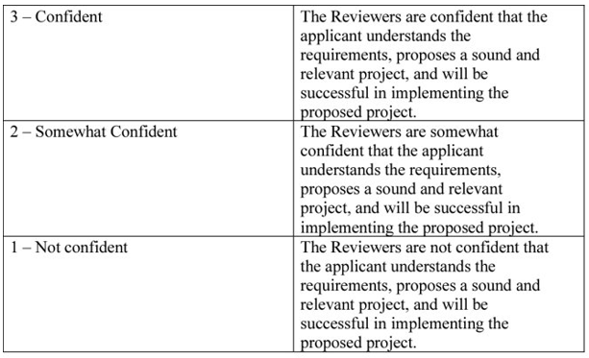
Confidence Rating System
Reviewers will score proposals using a Confidence Rating
system against a weighted criteria
Used by the federal government as an innovative practice that facilitates more holistic ratings, capturing reviewers’ overall confidence in the applicant’s likelihood to succeed
Easier!
Faster!
Smarter!
Executive Office of the President, OMB Memo for Chief Acquisition Officers, Senior Procurement Executives on reducing procurement administrative lead time using modern business practices (January 15, 2020)
Outgoing Grants

Slide 20
FY24 CSCG Scoring (1 of 3)
Underserved Focus Program Priority (1-3 Rating; weighted at 15/100 points) – The proposal demonstrates a commitment to and impact on Underserved populations in Montgomery County.
Implementation Readiness Program Priority (1-3 Rating; weighted at 15/100 points) – The proposal demonstrates that the capital project, or at least the portion funded by Montgomery County, is very likely to begin implementation within the next 3 to 9 months.
Asset Ownership/Commitment Program Priority (1-3 Rating; weighted at 15/100 points) – The proposal demonstrates that the organization owns (or intend to buys) the land, building, or other asset that they are seeking funding to improve or acquire; OR the organization has a long-term (5+ years) commitment to a space owned by the jurisdiction or other institution that owns the property or asset.
Outgoing Grants

Slide 21
FY24 CSCG Scoring (2 of 3)
D. Sound Fiscal Management (1-3 Rating; weighted at 10/100 points) – Proposal demonstrates that the applicant has sound grant and fiscal management practices, will be able to track and maintain expense back-up documentation, submit financial reports for reimbursement, and could meet audit and other administrative requirements.
E. Budget and Financial Planning (1-3 Rating; weighted at 15/100 points) – Expenses and revenues for the capital project detailed in the Project Budget and Project Budget Narrative are consistent with the other parts of the proposal.
Outgoing Grants

Slide 22
FY24 CSCG Scoring (3 of 3)
F. Organizational Implementation Capability (1-3 Rating; weighted at 20/100 points) - The proposal demonstrates a clear, well-organized plan and team to implement the capital project.
G. Performance Plan (1-3 Rating; weighted at 10/100 points) - Applicant demonstrates in their Performance Plan a clear process to measure/evaluate the impact of the capital project on the target population/community and/or Montgomery County residents overall.
Outgoing Grants

Slide 23
Award Notification
Award notification letters are expected to be released roughly 4-6 weeks after the application deadline via email.
For successful applicants, the award agreement will contain funding restrictions; programmatic, administrative, and policy requirements; reporting documents including total budget along with the amount of grant funding for the program; and payment terms.
Outgoing Grants

Slide 24
Review Committee
Feedback: the Six Cs
Concise - Be concise, when possible. Review Committee Members (RCM) have difficulty absorbing information from long narratives.
Concrete – Be specific and direct in how your proposed project will achieve its stated goals. RCMs often see gaps in how a project will work.
Clarity – RCMs prefer that you include the question you are answering or add sub-headings for clarity. Application task uploads should also include the title of the application task, organization name and project title as headers.
Connection - All elements of your application should show a clear connection with the grant priorities and scoring criteria, as outlined in the NOFO.
Consistent - All elements of your application should be consistent with each other. RCMs often note a lack of consistency between budget and narratives.
Cite - Feel free to refence other application sections/Tasks (i.e. budget or staff plan) in your narratives. Specifically cite the application Task name so the RCM can go directly there. Hyperlinks to external sources (i.e. news article, research paper, your website, etc…) can be helpful too. Overall, no need to repeat information that is in other places in your application or external source.
Outgoing Grants

Slide 25
General Recommendations
Read and Follow Instructions!
Feel free to use graphics, charts, tables, maps, project workflows, and other non-narrative tools to clarify or enhance your proposal.
Develop, coordinate, and finalize your application offline and then upload all materials into the application.
Uploads in pdf format are preferred (except the Program Budget, MS Excel please) but other formats are also welcome. The application platform has difficulty reading Mac formatted documents (i.e. Pages, Numbers, and Key Note) so these should be submitted as PDFs or converted to MS Office formats.
Outgoing Grants

Slide 26
Resources
The following resources are/will be posted on the application page:
Notice of Funding Opportunity (NOFO)
Link to a recording of the Information Session
Information Session slide deck
FY24 CSCG Project Budget Template
OGM Answers to Information Session and Frequently Asked Questions
Outgoing Grants

Slide 27
Further Questions?
Olga Kravets
Outgoing Grants Program Manager
Office of Grants Management
240-773-3344
grants@montgomerycountymd.gov
OGM online grants application platform for information, updates,
and to apply for County Grants (OGM website coming soon)
https://mcmdgrants.smapply.org

