Slide 1
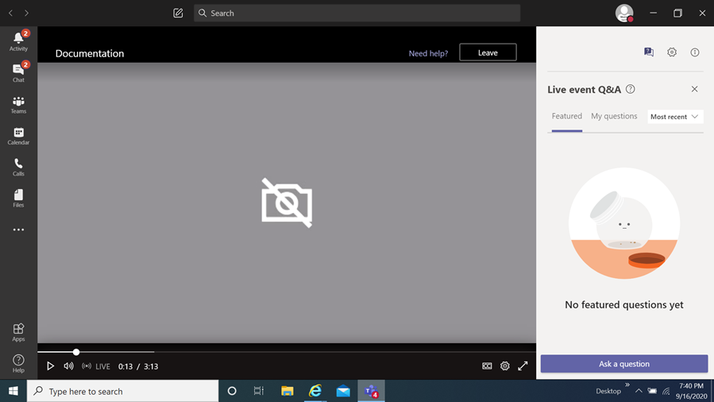
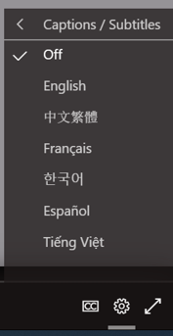
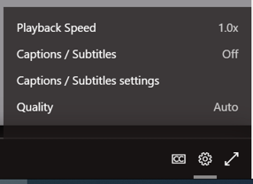
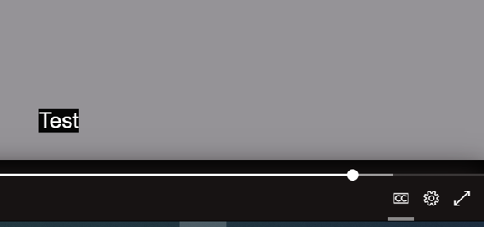
FY24 Place-Based Management Grants Program
Information Session
How you can view the multi-lingual closed captions
Select this item
When you select it a menu appears,
choose captions / subtitles
It will then display the language chosen
You then select
the language of choice
Disclaimer
The translations provided in this application use what is referred to as mechanical translation technology. Although this method of translation is very effective and provides a high rate of accuracy it is NOT 100% word for word accurate. Things that may affect it are the quality of the microphone used and potentially a person speaking that may have an accent.

Slide 2
FY24 Place-Based Management (PBM) Grants Program
Information Session
April 22, 2024
Prepared by Montgomery County Office of Grants Management

Slide 3
Welcome!
This meeting will be recorded and posted for future viewing on the Office of Grants Management online application portal
The slide deck will also be posted in the same location for your reference
Online Application Platform Home Page: https://mcmdgrants.smapply.org
Program Page:
https://mcmdgrants.smapply.org/prog/FY24PBM
Outgoing Grants

Slide 4
Information Session Agenda
Provide an overview of the program
Walk through the application platform
Open up for participant questions (put your questions in the Q&A box)
Any questions we cannot answer during the Information Session will be addressed and posted on the platform
Outgoing Grants

Slide 5
FY24 PBM
Overview
Program Goal: to enhance bottom-up economic development efforts serving residents and businesses by using Place-Based Management strategies aligned with the Main Street Approach. MCG is looking for proposals from qualified organizations that support economic growth and revitalization initiatives across the County’s commercial corridors, both nascent and established.
Application Due Date: Wednesday, May 8, 2024 at 11:59 PM
This is a competitive grants program that does not guarantee award
Outgoing Grants

Slide 6
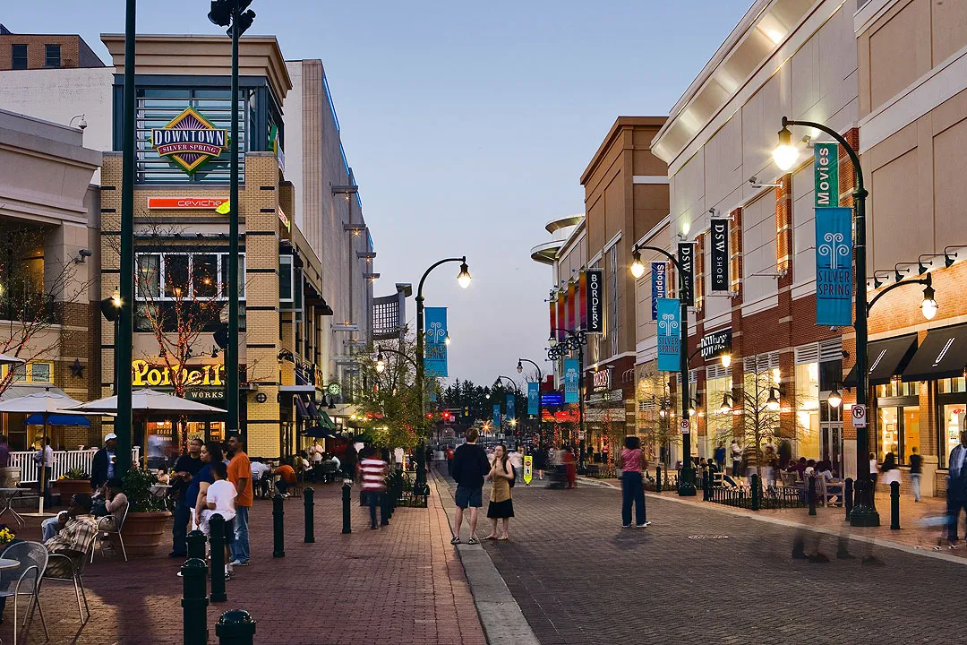
FY24 PBM
Target Population
The target populations for this grants
Program are businesses and residents
of the identified commercial corridor.
Outgoing Grants

Slide 7
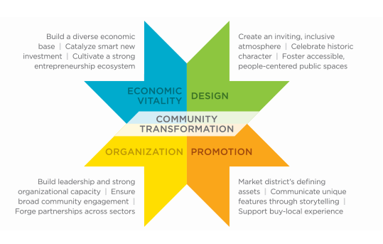
FY24 PBM
Funding Priorities
Priority in awarding funding will be given to projects which provide services or meet needs that fall under at least three of the four points of the Main Street Approach:
1. Economic Vitality focuses on capital, incentives, and
other economic and financial tools to assist new and
existing businesses, catalyze property development, and
create a supportive environment for entrepreneurs and
innovators that drive local economies.
2. Design supports a community’s transformation by
enhancing the physical and visual assets that set the
commercial district apart.
3. Promotion positions the downtown or commercial district as the center of the community and hub of economic activity, while creating a positive image that showcases a community’s unique characteristics.
4. Organization involves creating a strong foundation for a sustainable revitalization effort, including cultivating partnerships, community involvement, and resources for the district.
Outgoing Grants

Slide 8
FY24 PBM
Funding Priorities con’t
Furthermore, applications that demonstrate the following will be prioritized for funding:
Active engagement with stakeholders, as evidenced by
Broad-based community support for the commercial district revitalization process, with strong support from both the public and private sectors;
Plans for coordinating efforts with the County;
Well defined vision and mission statements relevant to community conditions, equity principles, and the project's stage as it relates to the Main Street Four Point Approach;
An operational board AND/OR committees staffed by volunteers that align with the Main Street Four Point Approach.
Outgoing Grants

Slide 9
FY24 PBM
Funding Priorities con’t
An adequate operating budget to support immediate implementation with indication towards future sustainability in funding;
A comprehensive project implementation plan;
A detailed plan to hire adequate staffing to meet project implementation needs.
MCG seeks proposals from organizations that:
Exhibit cultural proficiency;
Are inclusive of the LGBTQIA+ community members;
Use a racial equity lens in providing services.
Outgoing Grants

Slide 10
FY24 PBM Eligibility
Applicants must meet all the following conditions:
The organization must have a Federal 501(c)(3), 501(c)(6) tax-exempt status or be a collaboration between two or more entities with at least one having this status;
The organization must be currently registered and in Good Standing with the Maryland State Department of Assessments and Taxation (SDAT);
All activities and expenditures under this grant program must be provided in Montgomery County OR be exclusively for Montgomery County residents if activities and expenditures occur outside of the County;
Current Montgomery County contract or grant award winners must be current on all reporting obligations for other awards and those reports must reflect substantial progress towards the goals of their awards;
Outgoing Grants

Slide 11
FY24 PBM Eligibility con’t
Applicants must meet all the following conditions:
Proposed expenses must be for a new activity, expansion of existing activities, or a combination of both. County funding cannot be used to supplant other funding for already planned activities;
Applicants may only submit one application per organization under this NOFO;
Organizations that were funded under this program last year are eligible to apply. If submitting a multi-year application, please note that FY23 counts as Year 1. As such, they may submit applications that request funding for up to two more years.
Outgoing Grants

Slide 12
FY24 PBM
Ineligible Expenses
Capital expenses defined as expenses that are $5,000 or more one-time costs for the purchase of a fixed asset. For example, procurement of a car, property, remodeling a property, building an addition to a community center etc.
Grant funds can’t be used to purchase goods or services from Board Members’ organizations
Any purchase or activity which has already been made outside the grant award period of performance
Purchases or activities unnecessary to accomplish grant purposes
Prior obligations of and/or, debts, fines, and penalties imposed on the Grantee
Lobbying
To supplant (replace) funds from other grant sources
Outgoing Grants

Slide 13
FY24 PBM
Award Information
Total Funds​ | $400,000​ ($200,000 for programs serving Silver Spring)
Anticipated number of awards​ | 2-5
Award Size​ | $25,000 - $200,000
Period of Performance​ | Up to 12 months​ (multi-year awards contingent on performance)
Anticipated Types of Awards​ | Tranche-funded
Outgoing Grants

Slide 14
Submission Guidelines
Submissions must come through the County’s SM Apply online application portal at https://mcmdgrants.smapply.org
All applications must be fully submitted online by Wednesday, May 8, 2024 at 11:59 PM
Applicants requesting an Americans with Disabilities Act (ADA) accommodation should contact the Office of Grants Management to discuss alternative submission options.
Outgoing Grants
Notes:
Switch to Rafael on this slide

Slide 15
Application Tasks
Applicant Information (Reusable) Task: Organization contact info and supporting documents (data fields and uploads)
Applicant Background (Reusable) Task: Organization size and leadership demographics (data collected will never be seen by Review Committees or used for awarding)
Project Strategy Task: Project data & narrative (10 page limit, data fields and uploads)
Project Budget and Budget Narrative Task: Project cost details (data fields, MS Excel upload); Budget Narrative/Justification Task: Brief explanation of the Project Budget (1 page limit, PDF upload)
Project Staffing Plan Task: key positions and SOW (1 page limit, PDF upload)
Project Work Plan/Timeline Task: Implementation schedule (1 page limit per year, PDF upload)
Performance Plan: Outline of metrics and outcomes to be achieved (1 page limit, PDF upload)
Optional Supporting Documents: (PDF upload)
Outgoing Grants

Slide 16
Other Preparations
Register and create a profile on the online application platform for each team member who will be working on your application.
Verify that your organization is registered with the Maryland State Department of Assessment and Taxation (SDAT). Click here to go to the SDAT Business Express site to confirm. Even if your organization is registered in another jurisdiction, you must be registered with SDAT for Montgomery County to finalize an award with your organization.
If your organization is not in Good Standing with SDAT, take the necessary steps to get back into Good Standing. SDAT will advise what steps are required. Montgomery County cannot finalize an award with you or organization if you are not in Good Standing. Your application for a grant could be disqualified if you are not in Good Standing.
Register with the Montgomery County Central Vendor Registration System (CVRS) by clicking here. If you or your organization receives an award from the County then you will need to be registered with CVRS to receive payments.
Outgoing Grants

Slide 17
Review Process
Montgomery County Government will convene a review panel made up of qualified employees, and possibly the broader community, selected for their experiences in the grant program’s subject area, grants administration, and/or project management.
The panel members will review and score applicant proposals based on the criteria and priorities established in the NOFO.
Final decisions will be made based on the scores, reconciliation of funding across categories, and other factors such as applicants past performance on previous County awards.
Outgoing Grants

Slide 18
FY24 PBM
Scoring
Criterion A: Alignment with Funding Priorities (30 points)
The proposed project provides services or meets needs that align with the Main Street Approach;
The proposed project includes an effective plan for engaging with stakeholders;
The applicant demonstrates a strong understanding of the assets, liabilities/challenges, and opportunities as they pertain to their target economic corridor and proposes an effective plan to leverage or address each.
Criterion B: Management and Programmatic/Operational Capacity (30 points)
The applicant sufficiently budgets for the proposed activities;
The applicant has adequate internal capacity to make the proposed project operational within 30 days of award;
The applicant demonstrates strong financial management capability;
The proposed budget and budget narrative are sufficiently detailed and all proposed costs are reasonable and justified in achieving project objectives;
The applicant appropriately budgets for staffing to implement the project; staff roles and responsibilities are clearly defined.
Outgoing Grants

Slide 19
FY24 HEECAP Homes
Scoring con’t
Criterion C: Feasibility of Design and Approach (25 points)
The proposed project can reasonably be expected to achieve the intended objectives;
The proposed project is financially sustainable and/or will stimulate the financial sustainability of the organization in the near to medium term;
The proposed indicators are verifiable and linked to the project’s objectives;
The applicant articulates a clear method to collect and measure indicator data.
Criterion D: Racial Equity and Cultural Proficiency (15 points)
The applicant demonstrates awareness and a strong commitment to implementing activities with a racial equity lens;
Applicant demonstrates the cultural proficiency to work with their target communities/beneficiaries and, if applicable, language minority populations;
The applicant’s activities demonstrate inclusivity of the LGBTQIA+ community members.
Outgoing Grants

Slide 20
Review Committee
Feedback: the Six Cs
Concise - Be concise, when possible. Review Committee Members (RCM) have difficulty absorbing information from long narratives.
Concrete – Be specific and direct in how your proposed project will achieve its stated goals. RCMs often see gaps in how a project will work.
Clarity – RCMs prefer that you include the question you are answering or add sub-headings for clarity. Application task uploads should also include the title of the application task, organization name and project title as headers.
Connection - All elements of your application should show a clear connection with the grant priorities and scoring criteria, as outlined in the NOFO.
Consistent - All elements of your application should be consistent with each other. RCMs often note a lack of consistency between budget and narratives.
Cite - Feel free to reference other application sections/Tasks (i.e. budget or staff plan) in your narratives. Specifically cite the application Task name so the RCM can go directly there. Hyperlinks to external sources (i.e. news article, research paper, your website, etc…) can be helpful too. Overall, no need to repeat information that is in other places in your application or external source.
Outgoing Grants

Slide 21
General Recommendations
Read and Follow Instructions in the NOFO!
Feel free to use graphics, charts, tables, maps, project workflows, and other non-narrative tools to clarify or enhance your proposal.
Develop, coordinate, and finalize your application offline and then upload all materials into the application.
Uploads in pdf format are preferred (except the Program Budget, MS Excel please) but other formats are also welcome. The application platform has difficulty reading Mac formatted documents (i.e. Pages, Numbers, and Key Note) so these should be submitted as PDFs or converted to MS Office formats.
Outgoing Grants

Slide 22
Resources
The following resources are/will be posted on the application page:
Notice of Funding Opportunity (NOFO)
Link to a recording of the Information Session
Information Session slide deck
OGM Answers to Information Session and Frequently Asked Questions
Outgoing Grants

Slide 23
Further Questions?
Olga Kravets
Outgoing Grants Program Manager
Office of Grants Management
240-773-3344
grants@montgomerycountymd.gov
OGM online grants application platform for information, updates,
and to apply for County Grants (OGM website coming soon)
https://mcmdgrants.smapply.org

