Slide 1
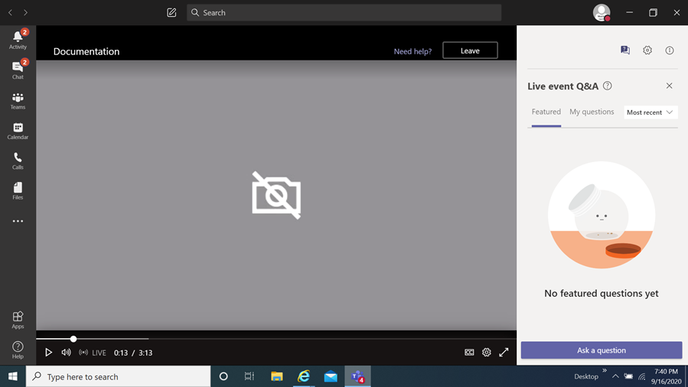
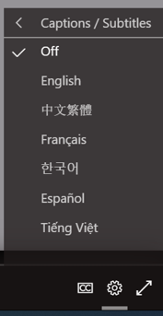
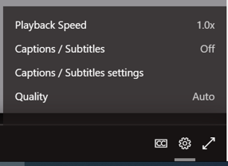
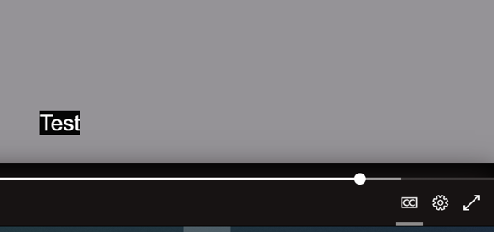
Community Reviewers
Information Session
How you can view the multi-lingual closed captions
Select this item
When you select it a menu appears,
choose captions / subtitles
It will then display the language chosen
You then select
the language of choice
Disclaimer
The translations provided in this application use what is referred to as mechanical translation technology. Although this method of translation is very effective and provides a high rate of accuracy it is NOT 100% word for word accurate. Things that may affect it are the quality of the microphone used and potentially a person speaking that may have an accent.

Slide 2
Community Grant Reviewer and FY24 Quarter 1 Community Projects Fund Training

Slide 3
Welcome and Thank You!
This meeting will be recorded and posted for future viewing on the Office of Grants Management online application portal
The slide deck will also be posted in the same location for your reference

Slide 4
Training Agenda
Community Grant Reviewer: Context and Process
Background
Contracting Process
Conflict of Interest
Agreement Upload in Grants Portal
Online Review Portal - Instructions
Payment Process
Community Projects Fund Quarter 1 Grants Program
Overview of the program
Review the application and review process
Go over review instructions, review form structure, and general review policies
Review the application, scoring criteria and questions
Questions and discussion

Slide 5
Community Grant Reviewer Training

Slide 6
Community Reviewers
Background
In January, OGM initiated a request for expressions of interest from community members to provide support with review of applications for various grant programs
Backlog of applications that need to be scored
One application is reviewed by at least three people each with a different review “lens”
Most immediate need: Community Projects Fund Quarters 1 & 2 and Nonprofit Technical Assistance and Management Support (NTAMS) Grant Program
Community Reviewers will be potentially recruited across all future County competitive grant programs

Slide 7
Community Reviewer Requirements
One or more of the following:
Subject Matter Expertise
Project Management
RESJ/Cultural Competence
have at least 5 years of demonstrated technical (professional/volunteer/academic) expertise and/or experience in one or more technical areas listed in the application.
at least 5 years of experience developing and managing projects, grants, budgets, and/or organizations as well as reviewing grants.
for a particular underserved community and/or Racial Equity and Social Justice experience - be intimately familiar with community needs, current initiatives and effective approaches aimed at addressing those needs at the local level.

Slide 8
Valuing Different Lenses
It’s flat like a sting ray!
It’s thick like a tree!
It’s long like a snake!

Slide 9
Community Reviewers
Grant reviewers must also:
Have intermediate proficiency in written and verbal English.
Demonstrate integrity and score applications based on set criteria
Ethically review proprietary information
Maintain confidentiality of information
Identify and report any conflicts of interest

Slide 10
Contracting Process
OGM sent you:
Notice of Funding Opportunity for CPF Q1 Grants Program
List of applicants under CPF Q1
Scope of Work that lists number of applications you will be assigned, the rate per application, and due date of April 30 to complete reviews
Reviewer Agreement

Slide 11
Conflicts of Interest
When signing the agreement, you are certifying
You are not an applicant under the specific program
You are not an employee of MCG (does not apply to MCPS, Montgomery College, Workforce Montgomery)
You are not a current or former (within the past three years) employee, volunteer, Board member, consultant, or contractor for an organization that has submitted an application under the NOFO
You do not have a family member who is a current or former employee, volunteer, Board member, consultant, or contractor for an organization that has submitted an application under the NOFO
Neither you nor any member of your have any financial, social, or personal interest in the outcome of the subject grant award

Slide 12
Agreement Upload in Grants Portal
Go to https://mcmdgrants.smapply.org
Log in using the same account you used to complete the Reviewer Application
Go into your application
Complete the task assigned to you called CPF Q1 Reviewer Agreement Upload
Complete the form and upload your agreement

Slide 13
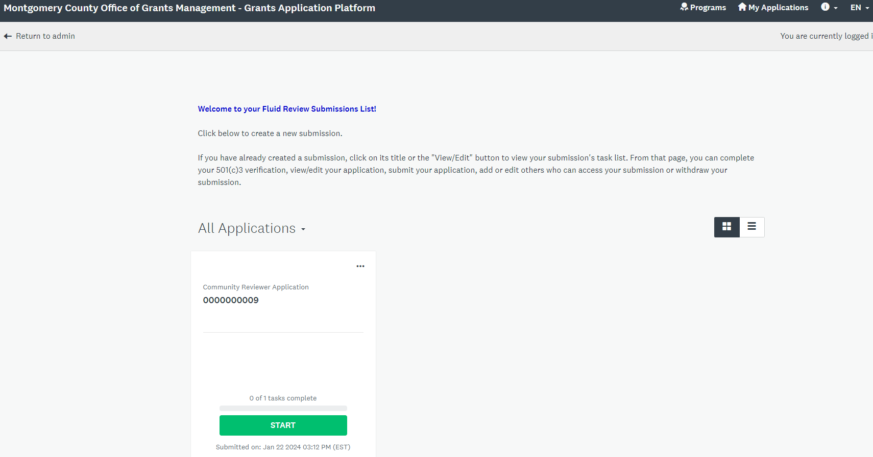
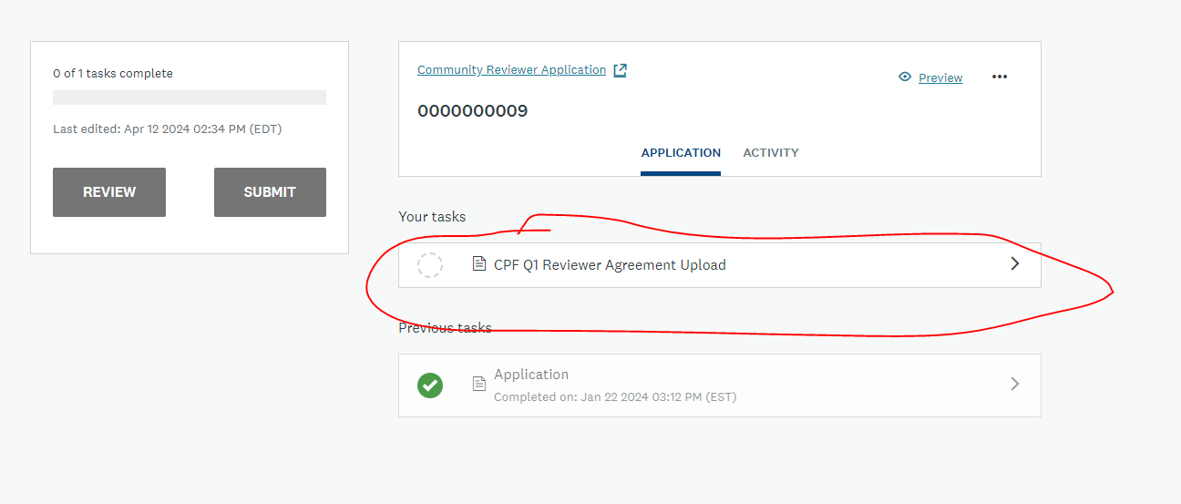
Agreement Upload in Grants Portal

Slide 14
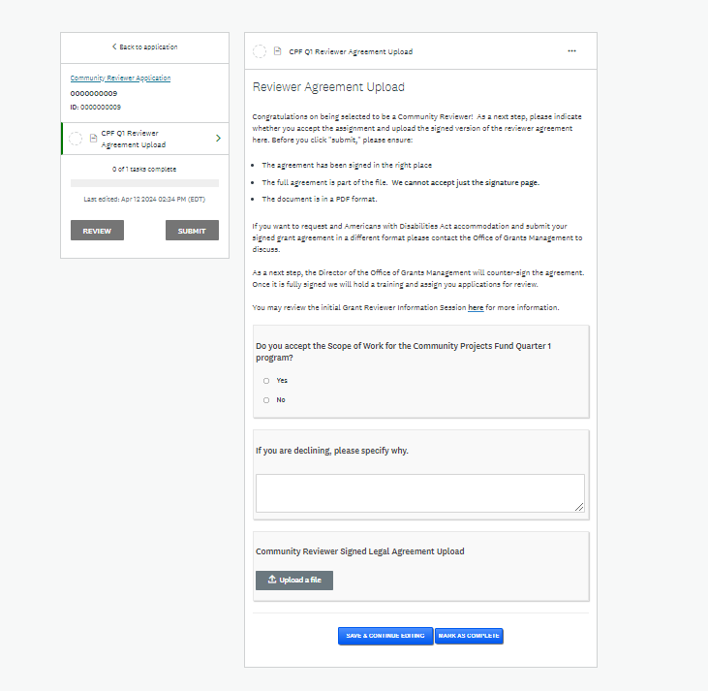
Agreement Upload in Grants Portal

Slide 15
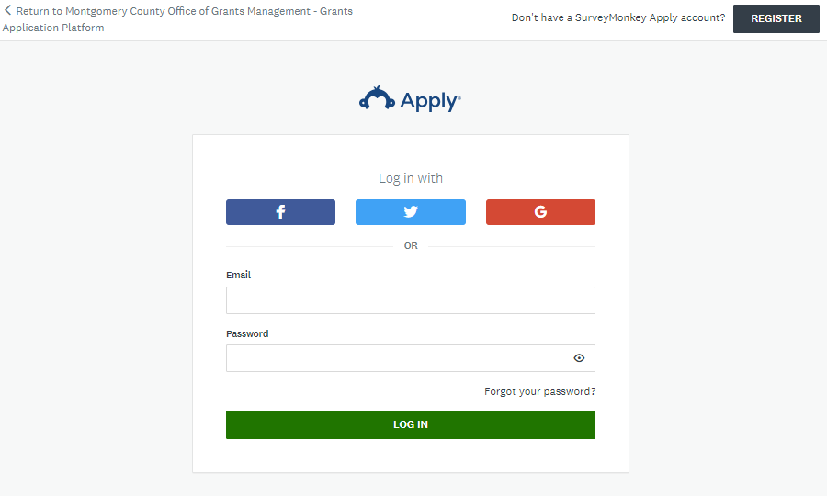
Online Review Portal - Instructions
Log-in to the SM Apply platform at https://mcmdgrants.smapply.org
All reviews must be conducted using OGM’s online grants application platform (SM Apply).
For additional guidance:
Reviewing Application FAQ

Slide 16
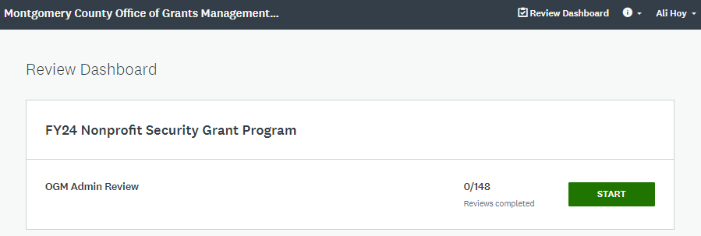
Online Review Portal - Instructions
Start reviewing applications via the Review Dashboard
Select “Start” to open the list of pending applications

Slide 17
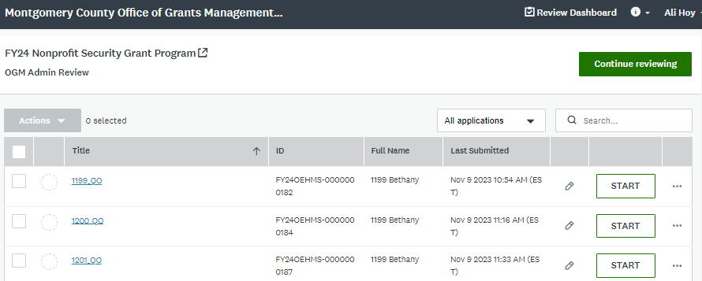
Online Review Portal - Instructions
Access specific application details
Select “Start” to open a specific application to review or “View” to open an application you have reviewed

Slide 18
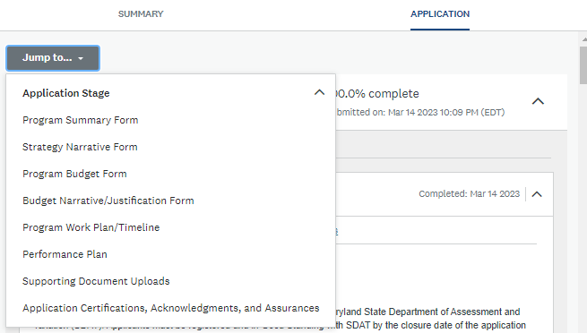
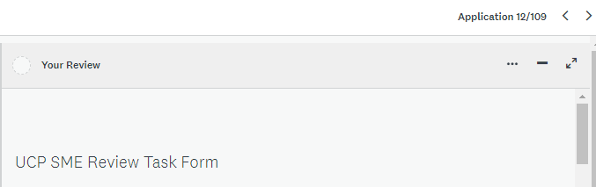
Online Review Portal - Instructions
Left side of the screen: Application
Select “Application” view (default is “Summary” view).
Scroll through the application or “Jump to…” specific application sections.
Tip: use the carrot symbol (^) to condense sections
Right side of the screen: Review Form
Report conflicts of interest
Criterion A-E: Review the scoring criteria and provide scores based on the weight and sub-criteria outlined.
Tip: use the carrot symbols (< >) to navigate to the previous or next application assigned to review
Tip: use the symbols to adjust the review panel window (minimize, pop-out). View details about these features.

Slide 19
Payment Process
Make sure you are registered in the Central Vendor Registration System
Name must match the name in the agreement
ACH selected as Payment Method
After completing all reviews, complete the Community Reviewer Invoice Template found on the Reviewer Application Page
Submit your invoice within the “Invoice Submission” task in SM Apply (same as the original agreement)

Slide 20
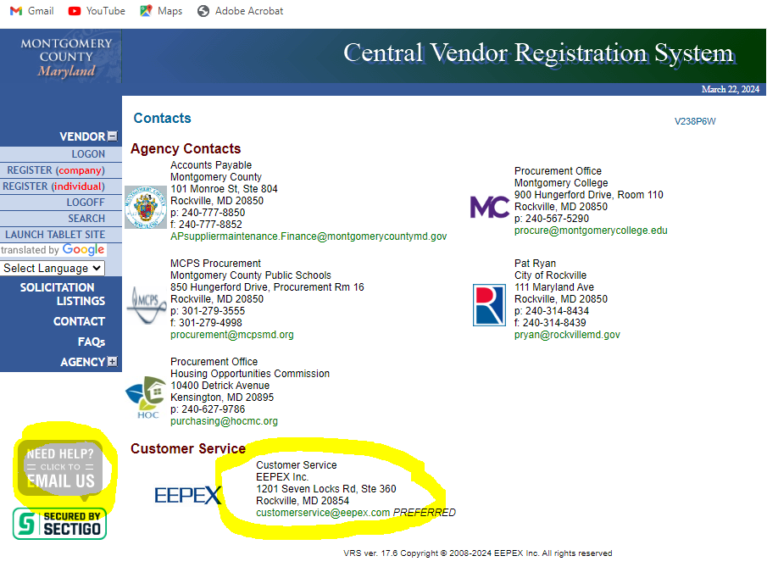
Central Vendor Registration System
For questions, contact CVRS Customer Service

Slide 21
FY24 Quarter 1 Community Projects Fund Training

Slide 22
All reviews will be conducted using OGM’s online grants application platform at https://mcmdgrants.smapply.org
You will be assigned applications in the portal after this training
FY24 Notice of Funding Opportunity (NOFO) (specifically pages 3-6,8-14, and 15-16 but all relevant information will be included in platform)

Slide 23
FY24 Q1 Community Projects Fund Goals
Total Funds for this Quarter: $250,000
Award Size: $5,000-$25,000
Award Period of Performance: up to six months

Slide 24
FY24 Q1 Community Projects Fund Goals Con’t
Overall Goal: support small, community focused projects, initiatives, and events led by small, emerging, and volunteer led nonprofit organizations within Montgomery County with one-time funds
Target Populations: Montgomery County residents; Underserved Communities as priority
Funding Priorities:
projects that target needs not directly addressed by other MCG efforts, critical gaps in specific communities, cut across traditional sectors, or offer innovative and experimental approaches to complex issues.
support Small, Emerging, Volunteer Led organizations (annual budget <$250K, less than 3 FT staff)
Programming Requirement: new activity, expansion of existing activities, or a combination of both (projects supported by Community Grants in previous years are accepted). County funding cannot be used to supplant other funding for already planned activities.
MCG Requirement: projects must target MoCo residents

Slide 25
Review Process
Initial training/meeting (today)
Each reviewer independently scores each application
OGM analyzes results (full data set available to reviewers upon request)
Scores and rankings data consolidated into award recommendations
OGM collates scoring results into CAO memo
Upon confirmation, OGM notifies applicants of results
OGM and implementing departments begin processing grant agreements to award winners

Slide 26
Review Instructions
Each member of the review committee will assess each application for:
Programmatic Eligibility (OGM has already checked for legal eligibility),
Provide a score against set criteria, and
Make an ultimate recommendation if the application should be funded.
Each field must be addressed as part of your review with concise and direct comments that explain your score. As you develop your responses, please note your comments and scores may:
In part or whole be shared with the applicants to provide transparency on the decision-making process or as a feedback measure to help them improve their proposal writing skills. Identities of reviewers will remain anonymous;
Become public through a Maryland Public Information Act (MPIA) request;
Be subject to an audit from the Office of the Inspector General, the Office of Legislative Oversight, or a similar County entity.

Slide 27
General Review Policies
Judge the impact of the proposed project, not the polish of the proposal. Montgomery County is one of the most diverse communities in America. However, not all applicants may have the experience or training to develop highly refined proposals. However, their proposed projects may reflect the best solutions for problems within their specific communities.
Score proposals with a consistent method, including adjusting scores on previously reviewed applications if necessary to maintain this consistency. As reviewers go through the applications and gain a sense of the broader quality of the overall pool, they may feel that their scoring of early applications is no longer accurate. If this is the case, reviewers are encouraged to go back to already completed applications to adjust scores (up or down) as necessary to maintain a consistent scoring method.
Review proposals independently, your scoring approach does not need to be consistent with peers. Reviewers are bringing different expertise and experience to the table, as well as diverse life perspectives. This will likely result in different scores between reviewers. Remember that we intentionally structured the review process to include different lenses.

Slide 28
General Review Policies Cont’d
Provide concise, constructive comments. Brief comments that justify your score are not only helpful for the final awarding discussions, but may also be used to help applicants understand why their proposal was, or was not, funded.
Remember that your comments could become public. Not only may OGM use some of your comments to provide feedback to applicants, it is possible that through a MPIA request that they could be available to the public. Overall, make sure your comments are professional.

Slide 29
Review Best Practices
If you are not sure about something, state so in the comments. For example, if you are not certain whether a project is addressing a gap currently not covered by MCG, indicate that.
Proofread your comments. After completing your review, go back and check to make sure your comments make sense.
Do not penalize applicants for having a proposal that does not align with the season. The application were submitted back in the summer 2023; we will provide applicants with an opportunity to submit a revised proposal. Score the proposal just on its merits.

Slide 30
Application Materials
Task | Description
Project Strategy Form | Project title, goal, total cost and Montgomery Funding Request Project Strategy Narrative
Project Budget Form | Project Budget (can be in any format) Should contain detailed itemized cost information for all proposed expenses plus indirect costs
Budget Narrative/Justification Form | Budget Narrative should describe proposed expenditures and address 3 questions as applicable
Project Work Plan/Timeline | Project Work Plan/Timeline should outline the implementation schedule of the proposed program over the maximum six (6) month grant performance period
Performance Plan and Performance History | Performance Plan Form outlines how success will be measured. Applicants free to submit their own metrics or milestones
Supporting Document Uploads | Optional proposal related and background materials

Slide 31
Benchmark Application Materials
OGM developed a sample application that we considered strong to serve as a benchmark both applicants and reviewers:
Strategy Narrative
Budget
Budget Narrative
Performance Plan
Work Plan

Slide 32
Scoring: 100 Possible Points
Project Goals and Grant Program Priorities (20 points)
Sound Fiscal Management and Budget (15 points)
Organizational Capability and Relevant Experience (35 points)
Performance Plan (10 points)
Soundness of the Overall Proposal (20 points)

Slide 33
Scoring: Confidence Rating Scale
Evaluate the proposals using the following confidence ratings:
Identified by the federal government as an innovative practice. For more information see https://www.whitehouse.gov/wp-content/uploads/2021/01/OFPPPALTMemorandum-01-14-2021.pdf
3 – Confident | The Reviewers are confident that the applicant understands the requirements, proposes a sound and relevant project, and will be successful in implementing the proposed project.
2 – Somewhat Confident | The Reviewers are somewhat confident that the applicant understands the requirements, proposes a sound and relevant project, and will be successful in implementing the proposed project.
1 – Not confident | The Reviewers are not confident that the applicant understands the requirements, proposes a sound and relevant project, and will be successful in implementing the proposed project.

Slide 34
A. Project Goals and Grant Program Priorities (20 points)
Highest possible score for a project that:
Is from a small, emerging, or volunteer led nonprofit organization;
Is from an organization based in or serving an Underserved Community;
Demonstrates a strong understanding of their target population’s/community’s needs and an effective project strategy to effectively meets these needs;
Provides services, advocacy, or other support to the target population/community that is not already funded by other County resources;
Provides technically, culturally, and/or linguistically proficient services to the target population/community;
Demonstrates a broad base of impact through their proposal to their target population/community; and
Will be fully implemented within six (6) months (Do not penalize applications based on disconnect between application timeline and review period).

Slide 35
B. Sound Fiscal Management and Budget (15 points)
Applicant demonstrates sound grant and fiscal management practices and will be able to submit financial reports and back-up documentation to meet administrative and audit requirements (5 points);
Expenses listed in the Budget and Budget Justification are consistent with the Project Strategy and other parts of the proposal (5 points);
Applicant’s Budget and Budget Justification reflect reasonable and realistic costs needed to implement the proposal and achieve the stated outcomes for the target population/community (5 points)

Slide 36
C. Organizational Capability and Relevant Experience (35 points)
Applicant demonstrates the cultural, linguistic, and/or technical proficiency to work with their target population/community in the context of the proposed project (15 points);
Applicant demonstrates the subject-matter expertise to deliver the proposed outcomes to the target population/community (5 points);
Applicant demonstrates a strong relationship with their target population/community and can effectively perform outreach to promote, engage, and/or connect the target communities/populations with the proposed project (15 points).

Slide 37
D. Performance Plan (10 points)
Applicant demonstrates in their Performance Plan a clear process to measure/evaluate its project (5 points); and
Proposal’s choice of KPI’s/metrics, milestones, other evaluation methods, and ultimate outcomes fit the project strategy and Grant Program’s goals (5 points).

Slide 38
E. Soundness of the Overall Proposal (20 points)
Proposal clearly demonstrates the effectiveness of proposed activities and, if funded, will result in the accomplishment of their stated outcomes (5 points);
The implementation plan within the proposal is realistic and achievable based on the proposed timeline (10 points); and
Proposal’ contingency plans for a lower than requested funding amount is realistic and still results in desired outcomes albeit at a lower level (5 points)

Slide 39
Review Due Date
Reviews are due no later than April 30, 2024.
Please let us know as soon as possible if you are unable to meet the deadline
THANK YOU

Slide 40
Questions?

Slide 41
Office of Grants Management
Olga Kravets, Program Manager
grants@montgomerycountymd.gov
(240)773-3344

